Slide 1
Urban Agriculture
Post Harvest
www.erikchevrier.ca

Slide 2
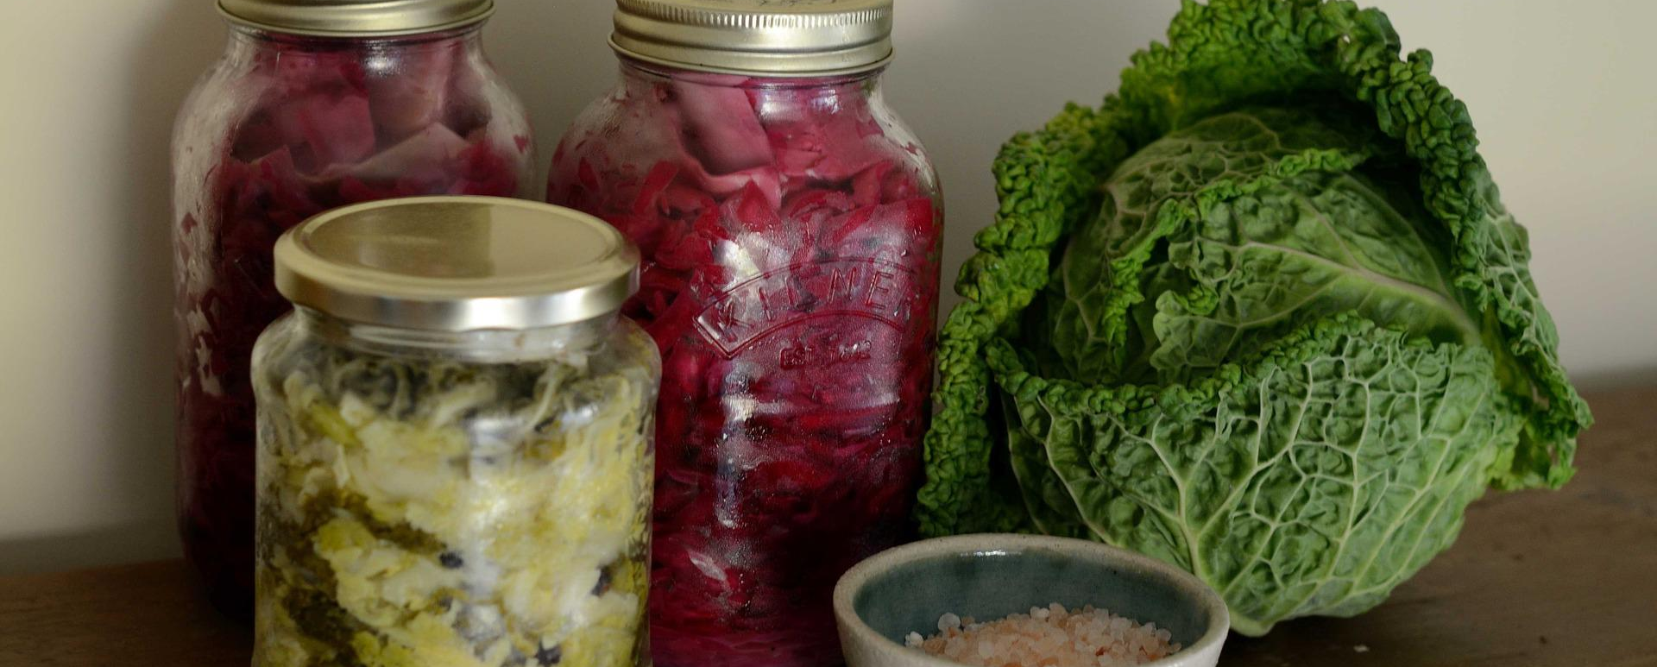
Lacto-fermentation
Lacto-fermentation is the process by which bacteria break down the sugars in foods and form lactic acid. Lacto-fermented foods include yogurt, sauerkraut, kimchi, and pickles

Slide 3
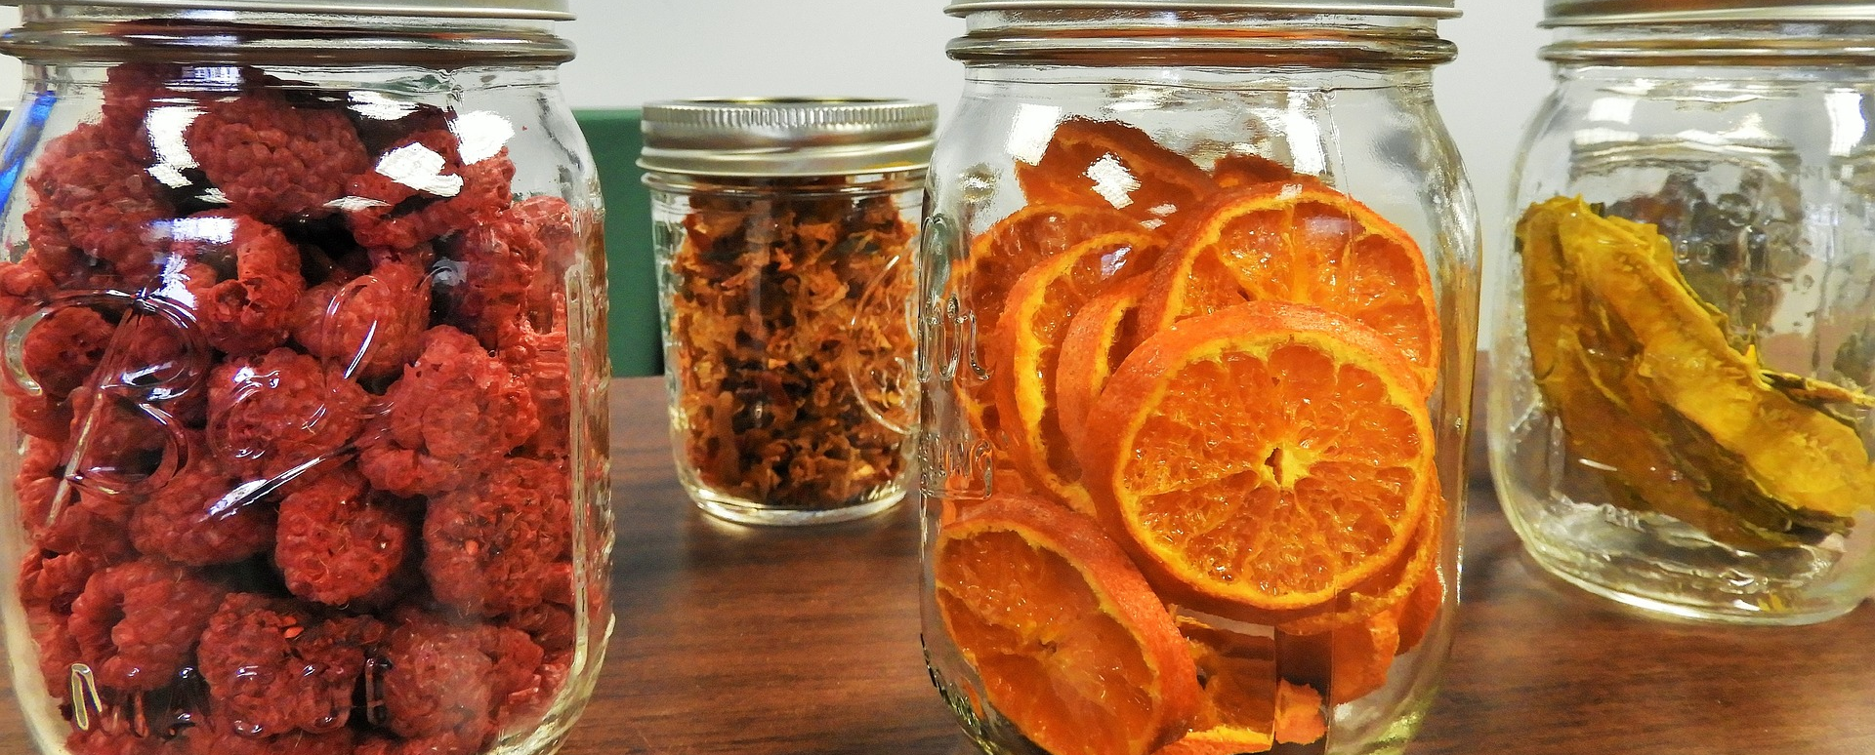
Dehydration
It is the process of removal of water from food. It is the simplest method and prevents food spoilage by removing water.

Slide 4
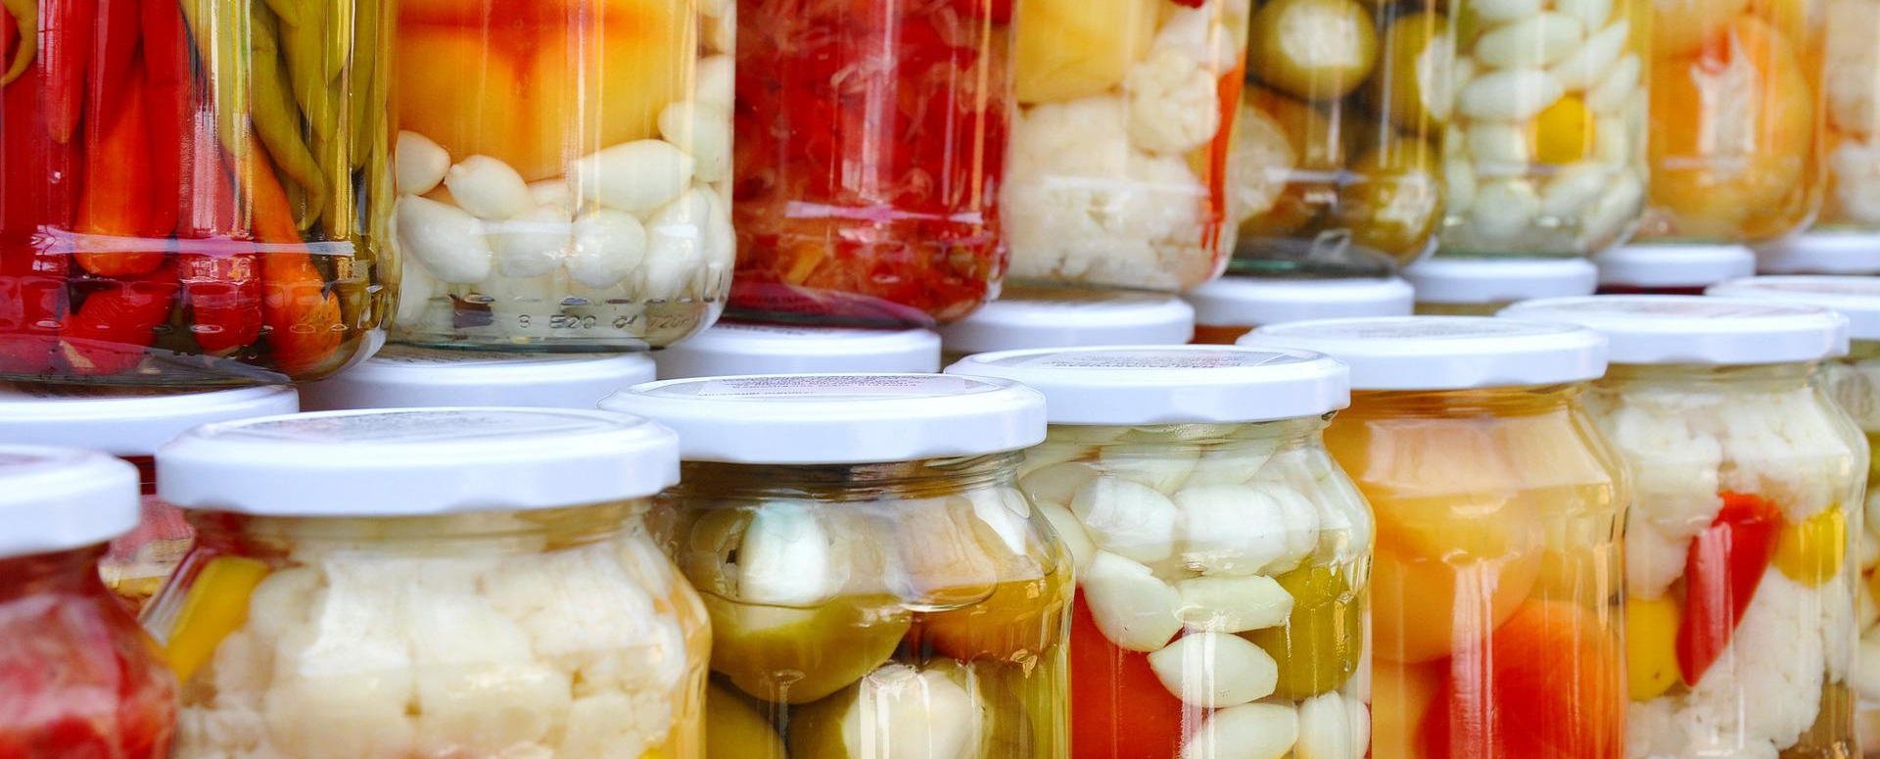
Waterbath and Pressure Canning
The food contents are sealed in an airtight container at high temperatures

Slide 5
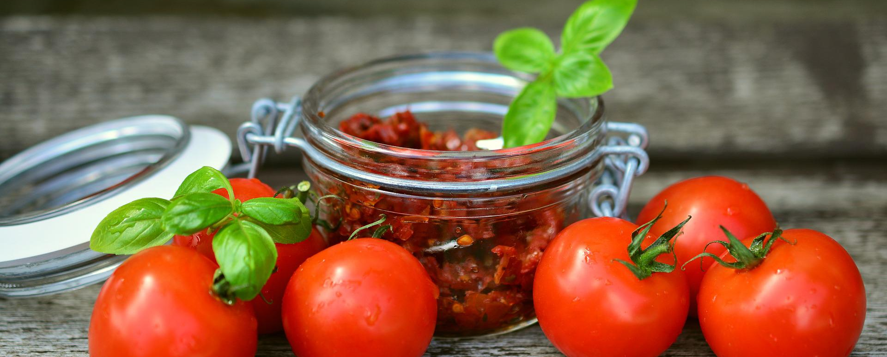
Oil / Vinegar
Oil and vinegar are used in food preservation because food spoilage microorganisms cannot survive in such an environment.

Slide 6
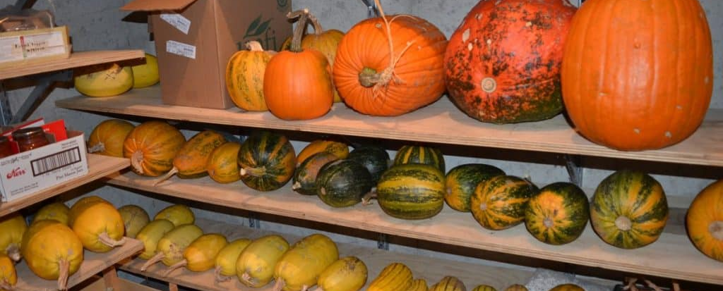
Cold Storage – Root Cellar
As a sustainable alternative to refrigerated or electrically cooled storage for crops needing cool damp conditions, traditional root cellars are a good option

Slide 7
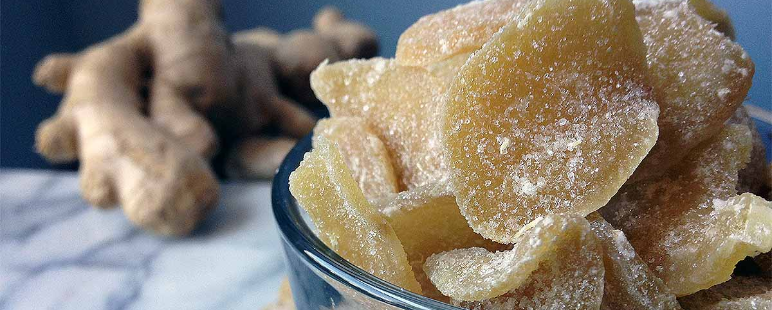
Sugar Preserving
https://foodal.com/recipes/canning/crystallized-ginger-candy/
Sugaring is the process of desiccating a food by first dehydrating it, then packing it with pure sugar. This sugar can be crystalline in the form of table or raw sugar, or it can be dense liquid saturated with sugar such as honey, syrup or molasses.

Slide 8
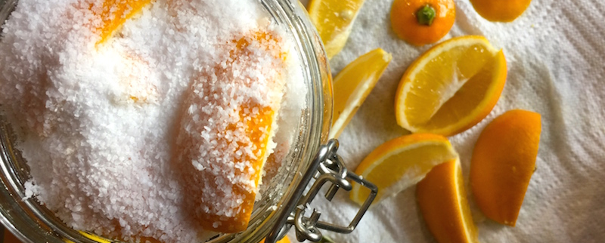
Salt Preserving
Salt dries food. Salt draws water out of food and dehydrates it. All living things require water and cannot grow in the absence of it. Salt is used to preserve beef jerky by keeping it dry, and it prevents butter from spoiling by drawing water out, leaving just the fat.

Slide 9
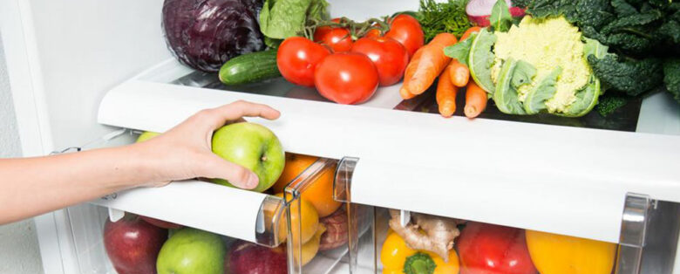
Refrigeration
Image: https://www.healthylivingly.com/diet/refrigerating-foods-and-the-process-of-preservation/
The most common food preserving method is to store food in the refrigerator. Refrigeration (cold temperature) slows down the bad bacterial growth greatly, so food lasts 10 or more times longer to spoil

Slide 10
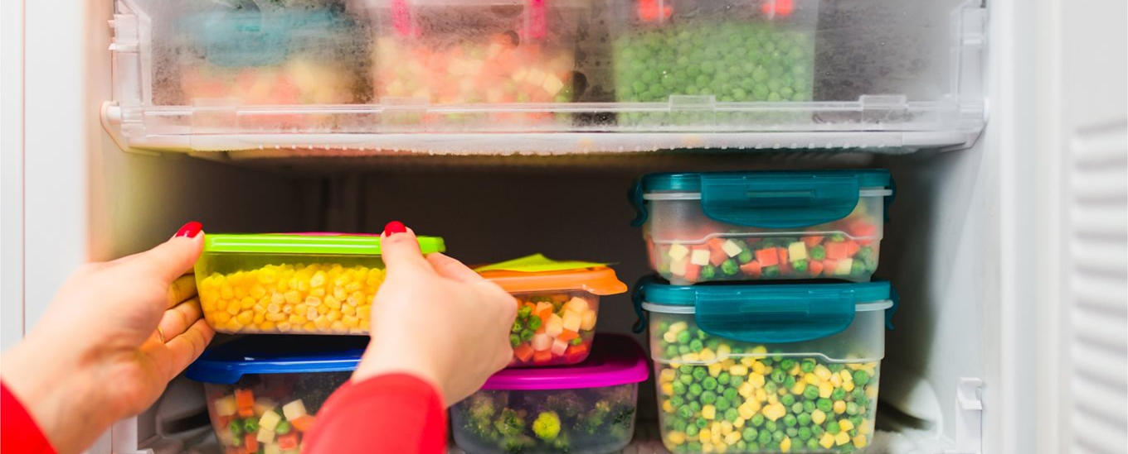
Freezing
Image: https://www.safefood.net/food-storage/freezing
Freezing is the easiest and least time-consuming method of preserving foods. Most foods freeze well—with the exception of produce with a high-water content, cream-based items, and cooked starchy foods such as cooked noodles and rice.

Slide 11
Food Safety
In Quebec, food safety is regulated by Ministère de l'Agriculture, des Pêcheries et de l'Alimentation (MAPAQ)
Contaminants:
Bacteria
Parasites
Viruses
Chemical and physical contaminants
Restaurant Condemnations

Slide 12
Food Temperature and Safety
Frozen food should be kept at maximum - 18 °C
Refrigerated foods should be between 2 and 4 °C
Some fruits with skin (tomatoes) should be kept at room temperature or cooled at 12°C
Hot food should be kept at a temperature of at least 60°C
DANGER ZONE: Between 35 – 45°C, bacteria doodles every 15 minutes

Slide 13
Great Tips
Preserved foods should be kept in a cool and dry environment to discourage bacterial growth and spoilage. Most food preservation techniques currently used, combine methods of smoking, drying, sugar and salt, preservatives, refrigeration, acidity and others.
Follow a tried a true recipe from a reputable source.

Slide 14
Questions?
Thank you. Have a great week.

