Slide 1
Cultivating Urban Greenspaces
Incorporating Perennial Berries
www.cultivaction.ca

Slide 2
Question?
What is a Perennial Plant?

Slide 3
What is a Perennial Plant?
Annual – Plant takes one year to complete its cycle (must be reseeded)
Biennial – Plant takes two year to complete its cycle (must be reseeded after two years)
Perennial – Plant lives for multiple years before its life cycle is complete

Slide 4
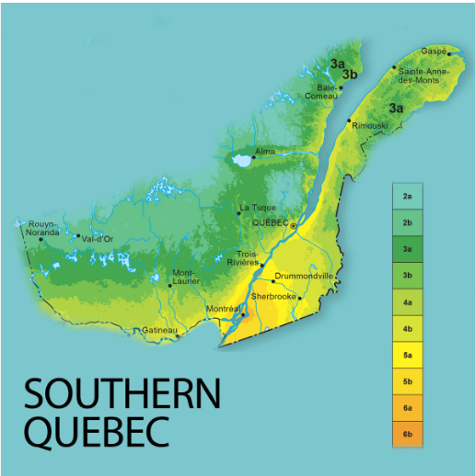
Hardiness Zones
https://gardenmaking.com/plant-hardiness-zones-changing/

Slide 5
Discussion
Do you want to incorporate perennial fruits and berries into the garden?
If so, what types of fruits and berries do you like?
What types of fruits and berries can we grow in Montreal’s hardiness zone? Name as many as you can and tell us about them.

Slide 6
List of Berries That Grow In Montreal
Berries
Gooseberry
Raspberry
Blackberry
Haskap Berry
Kiwi Berries
Currants
Serviceberries
Strawberries
Elderberries
Blueberries
Mulberries
Grapes
Aronia Berries
Bunchberries
Goji Berries
Sea Buckthorn
Boysenberry

Slide 7
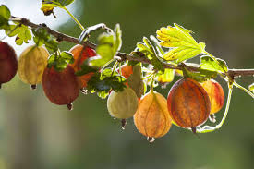
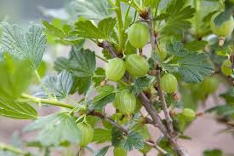
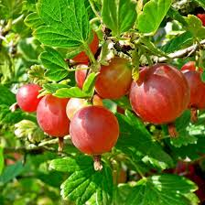
Gooseberry

Slide 8
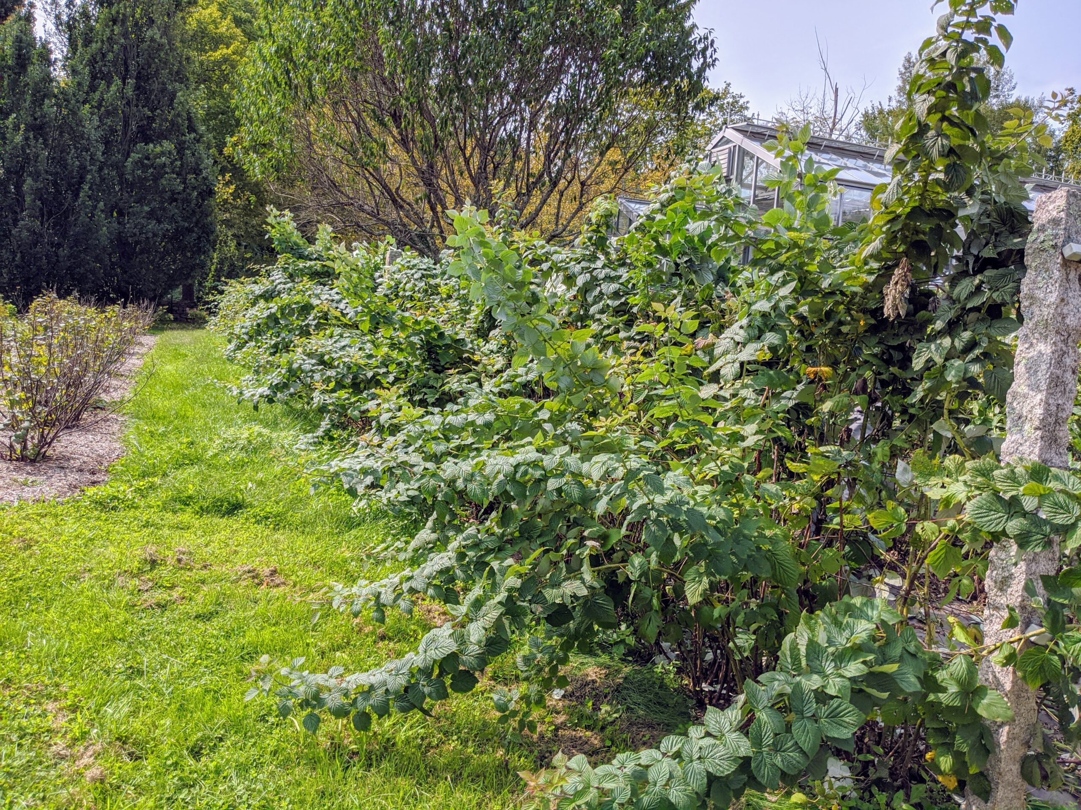
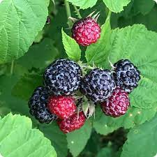
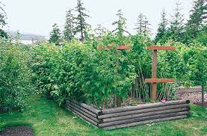
Raspberry

Slide 9
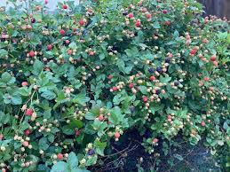
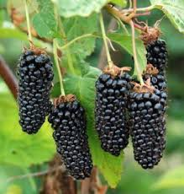
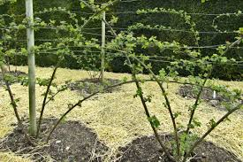
Blackberry

Slide 10
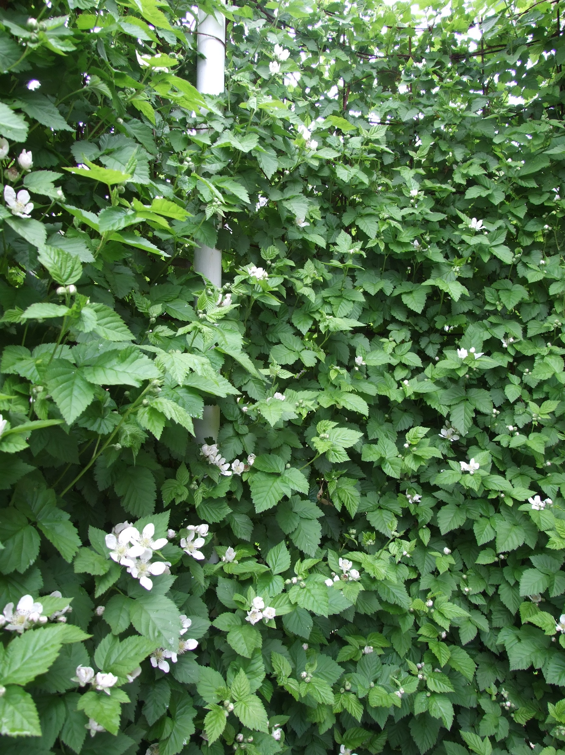
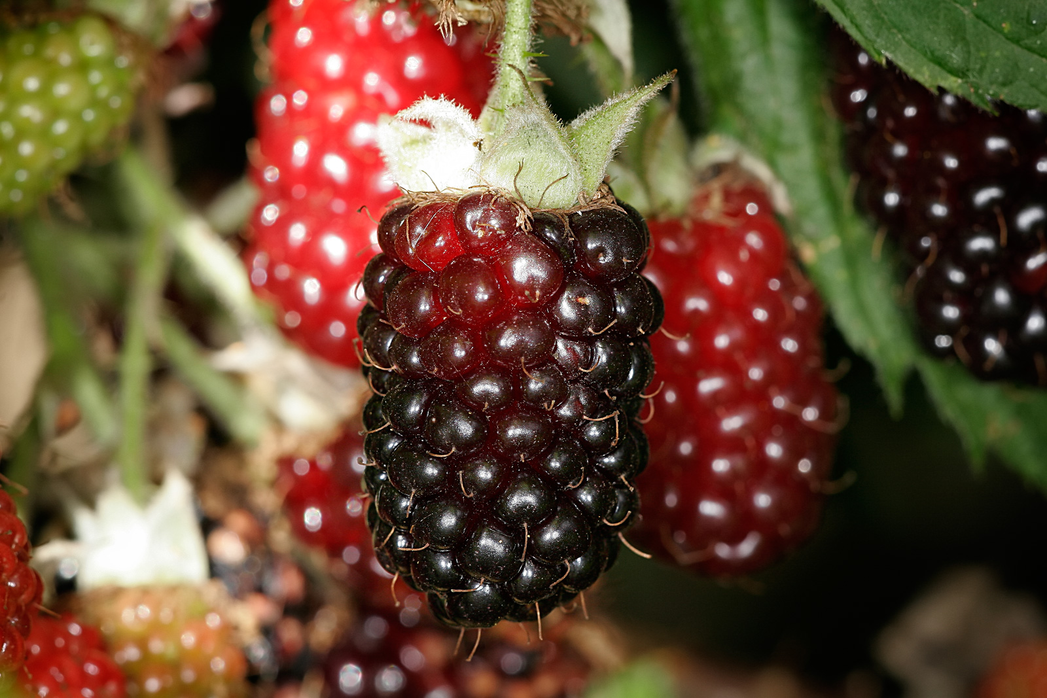
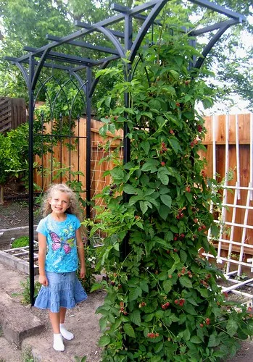
Boysenberry

Slide 11
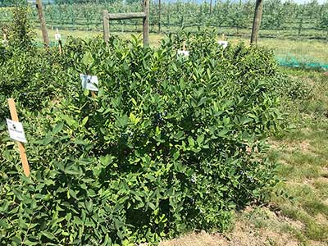
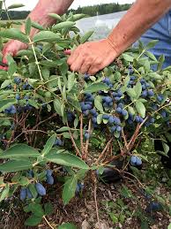
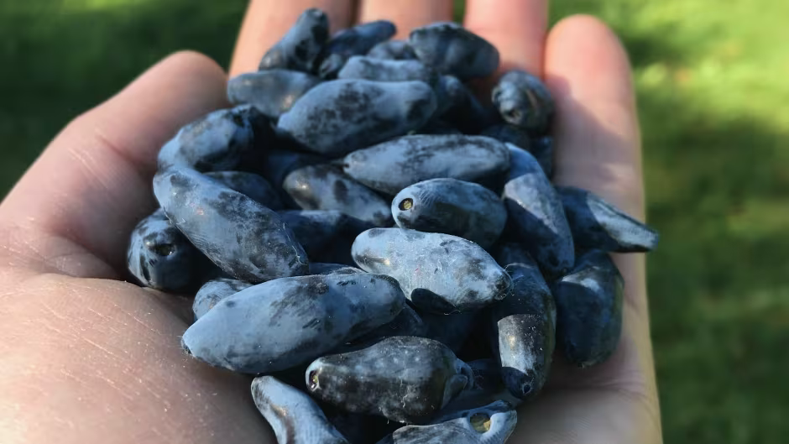
Haskap Berries

Slide 12
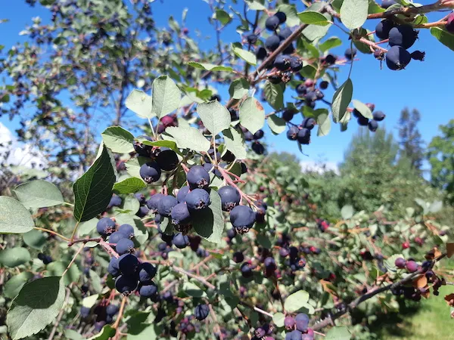
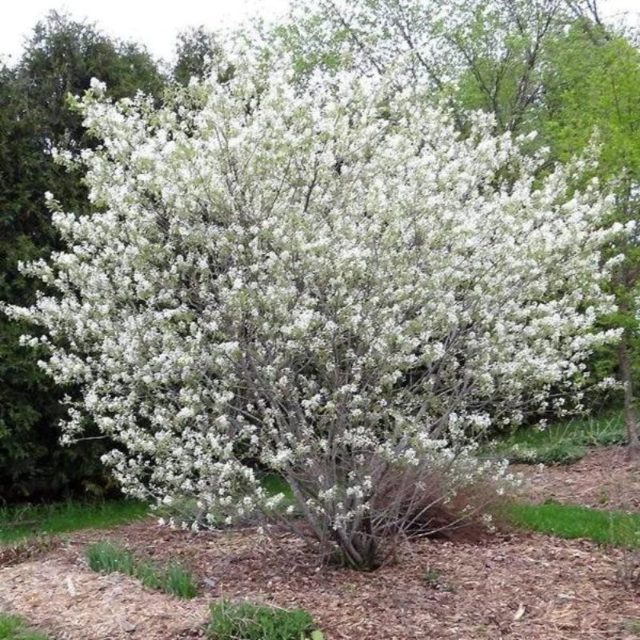
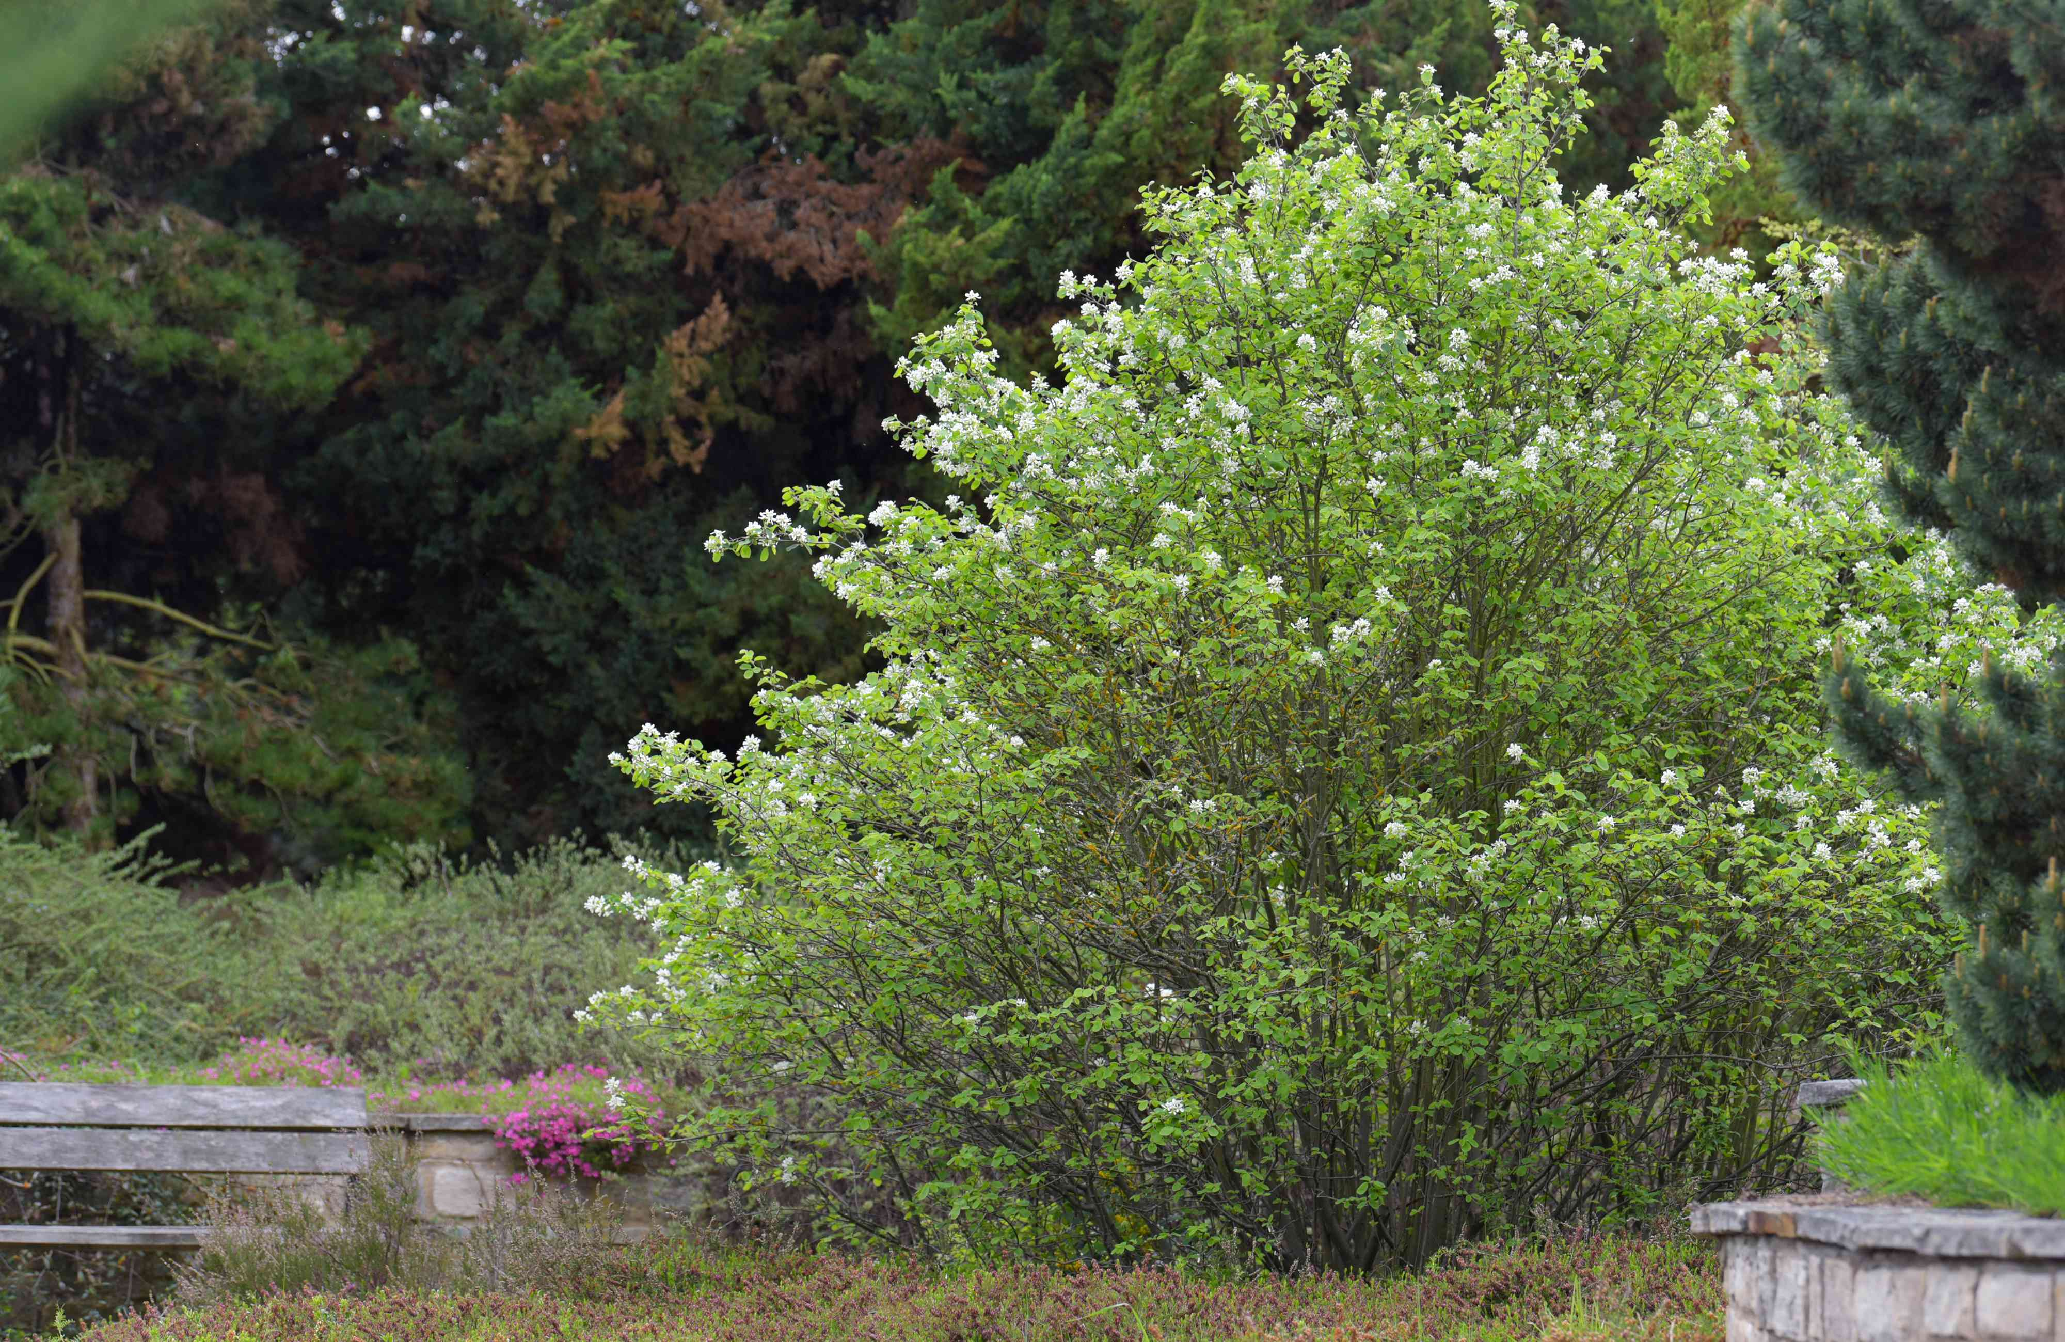
Serviceberry

Slide 13
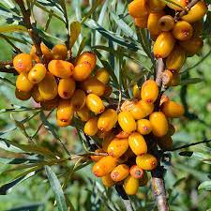
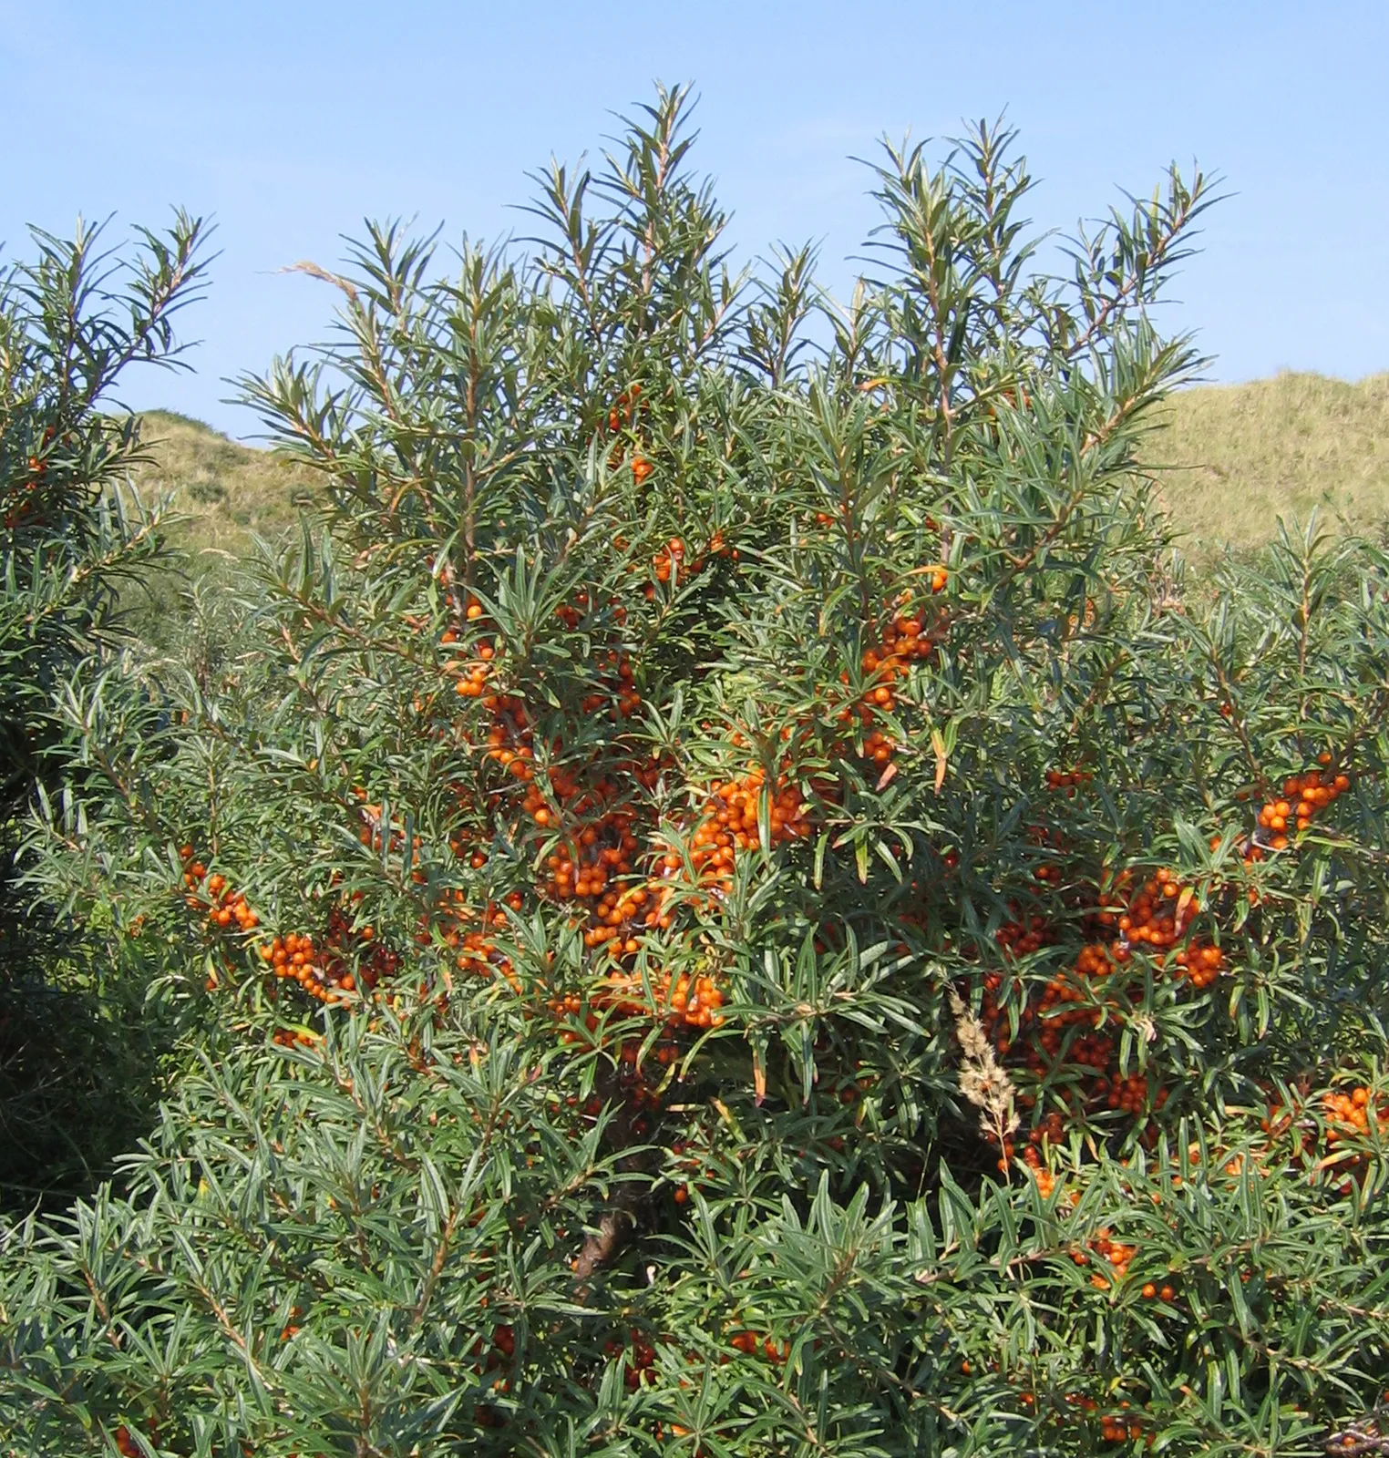
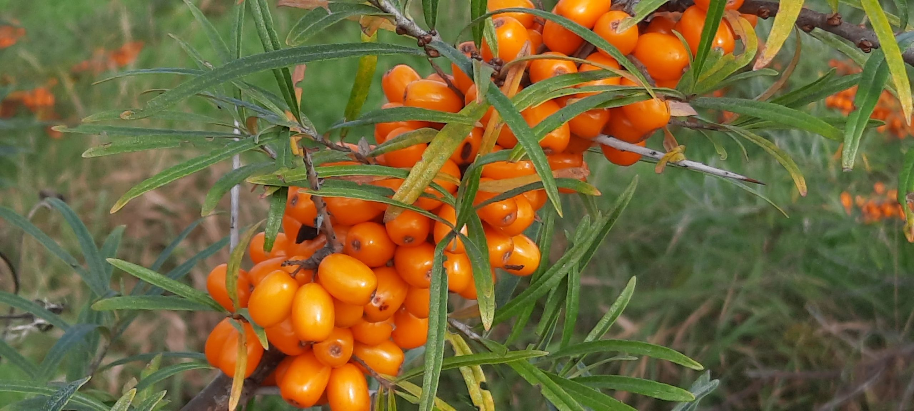
Sea Buckthorn Berries

Slide 14
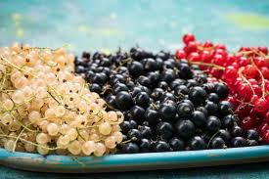
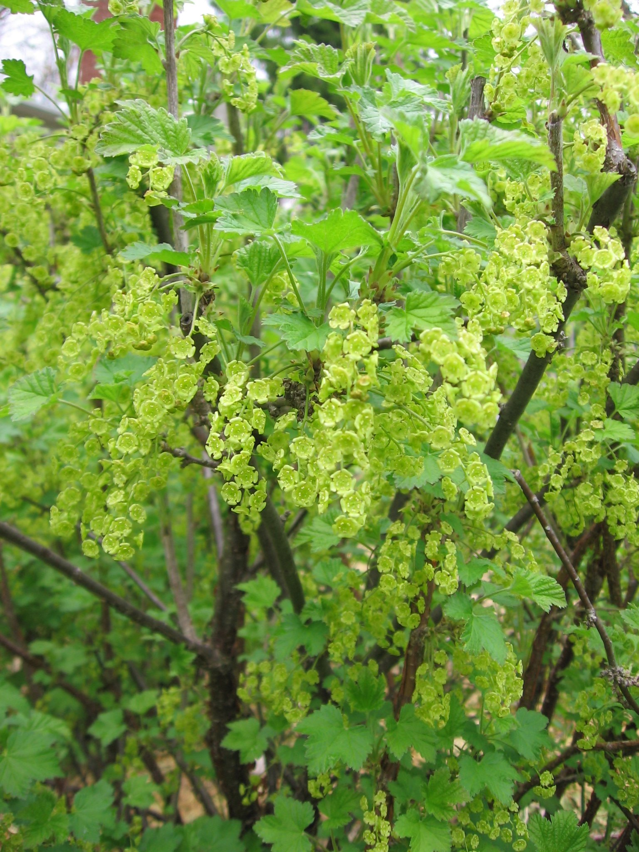
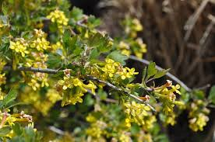
Currant Berries

Slide 15
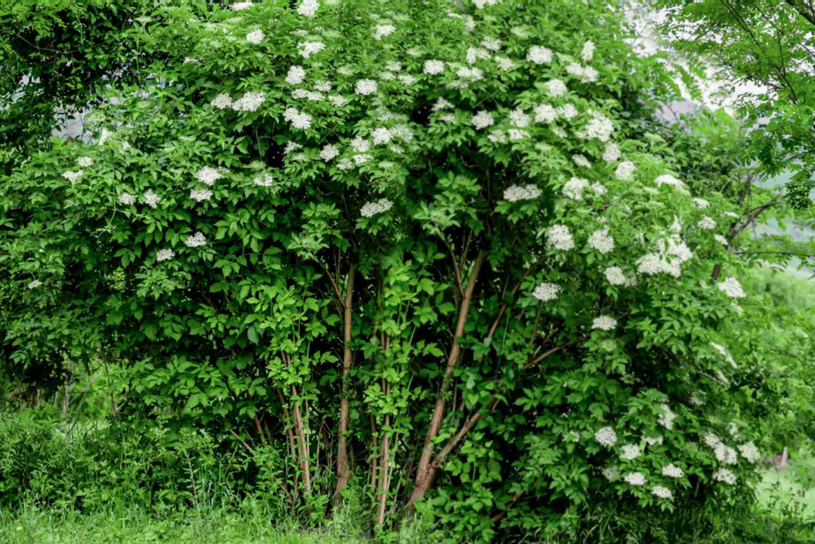
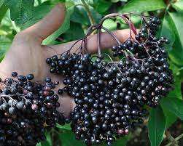
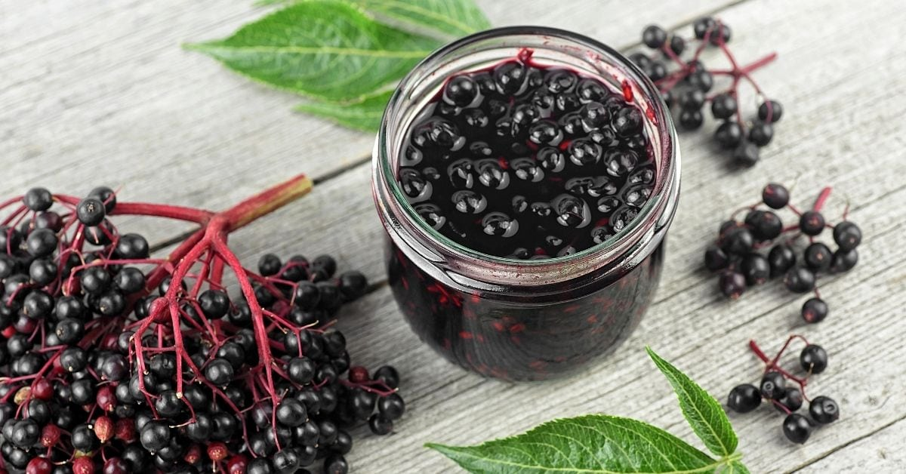
Elderberry

Slide 16
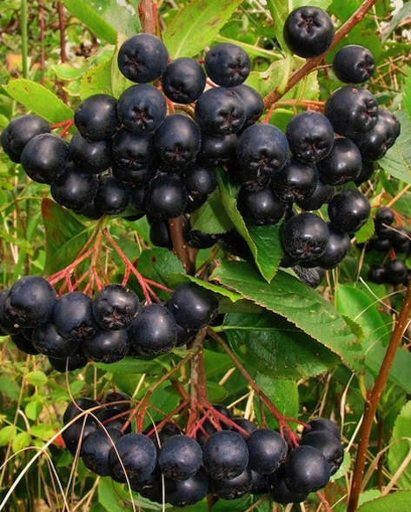
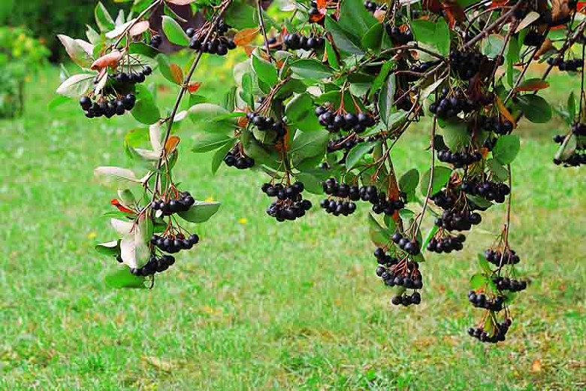
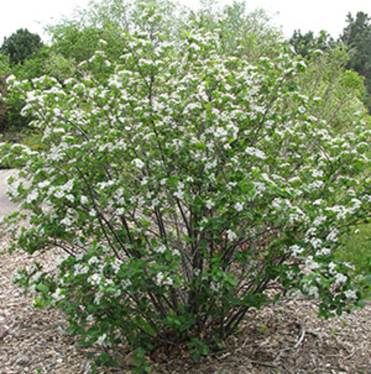
Aronia Berries

Slide 17
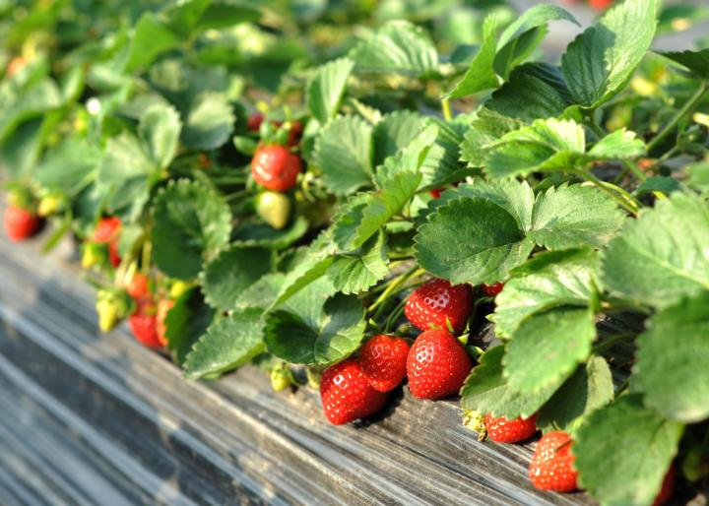
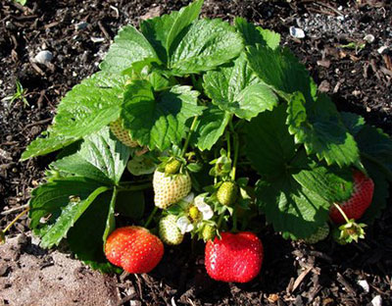
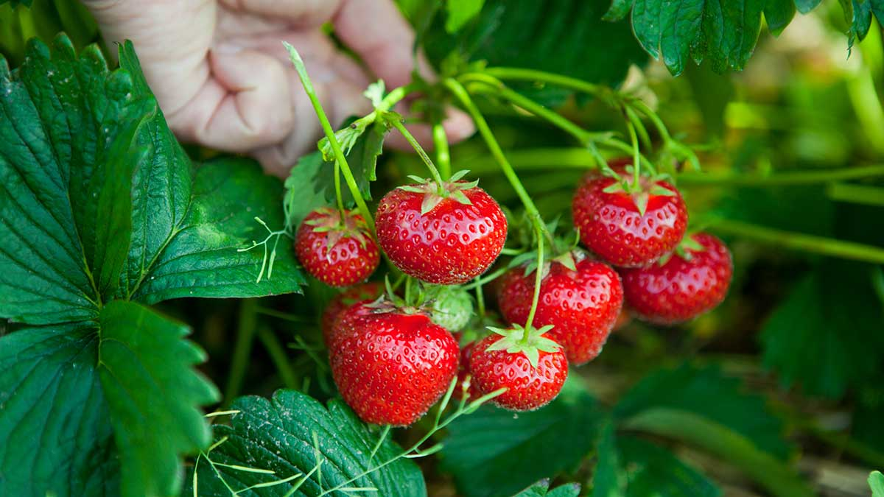
Strawberries

Slide 18
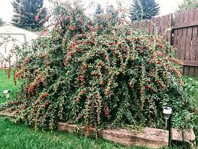
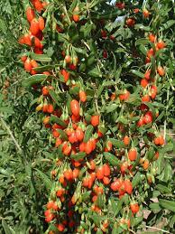
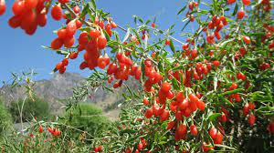
Goji Berries

Slide 19
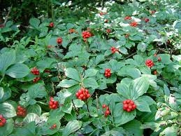
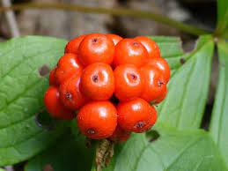
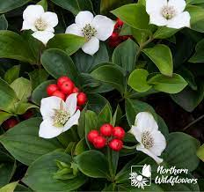
Bunchberry

Slide 20
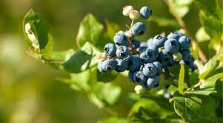
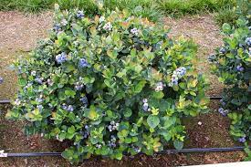
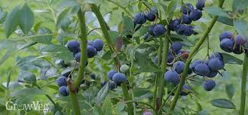
Blueberry

Slide 21
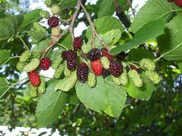
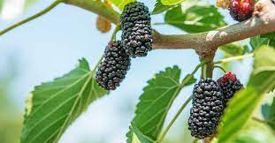
Mulberry

Slide 22
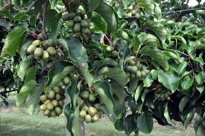
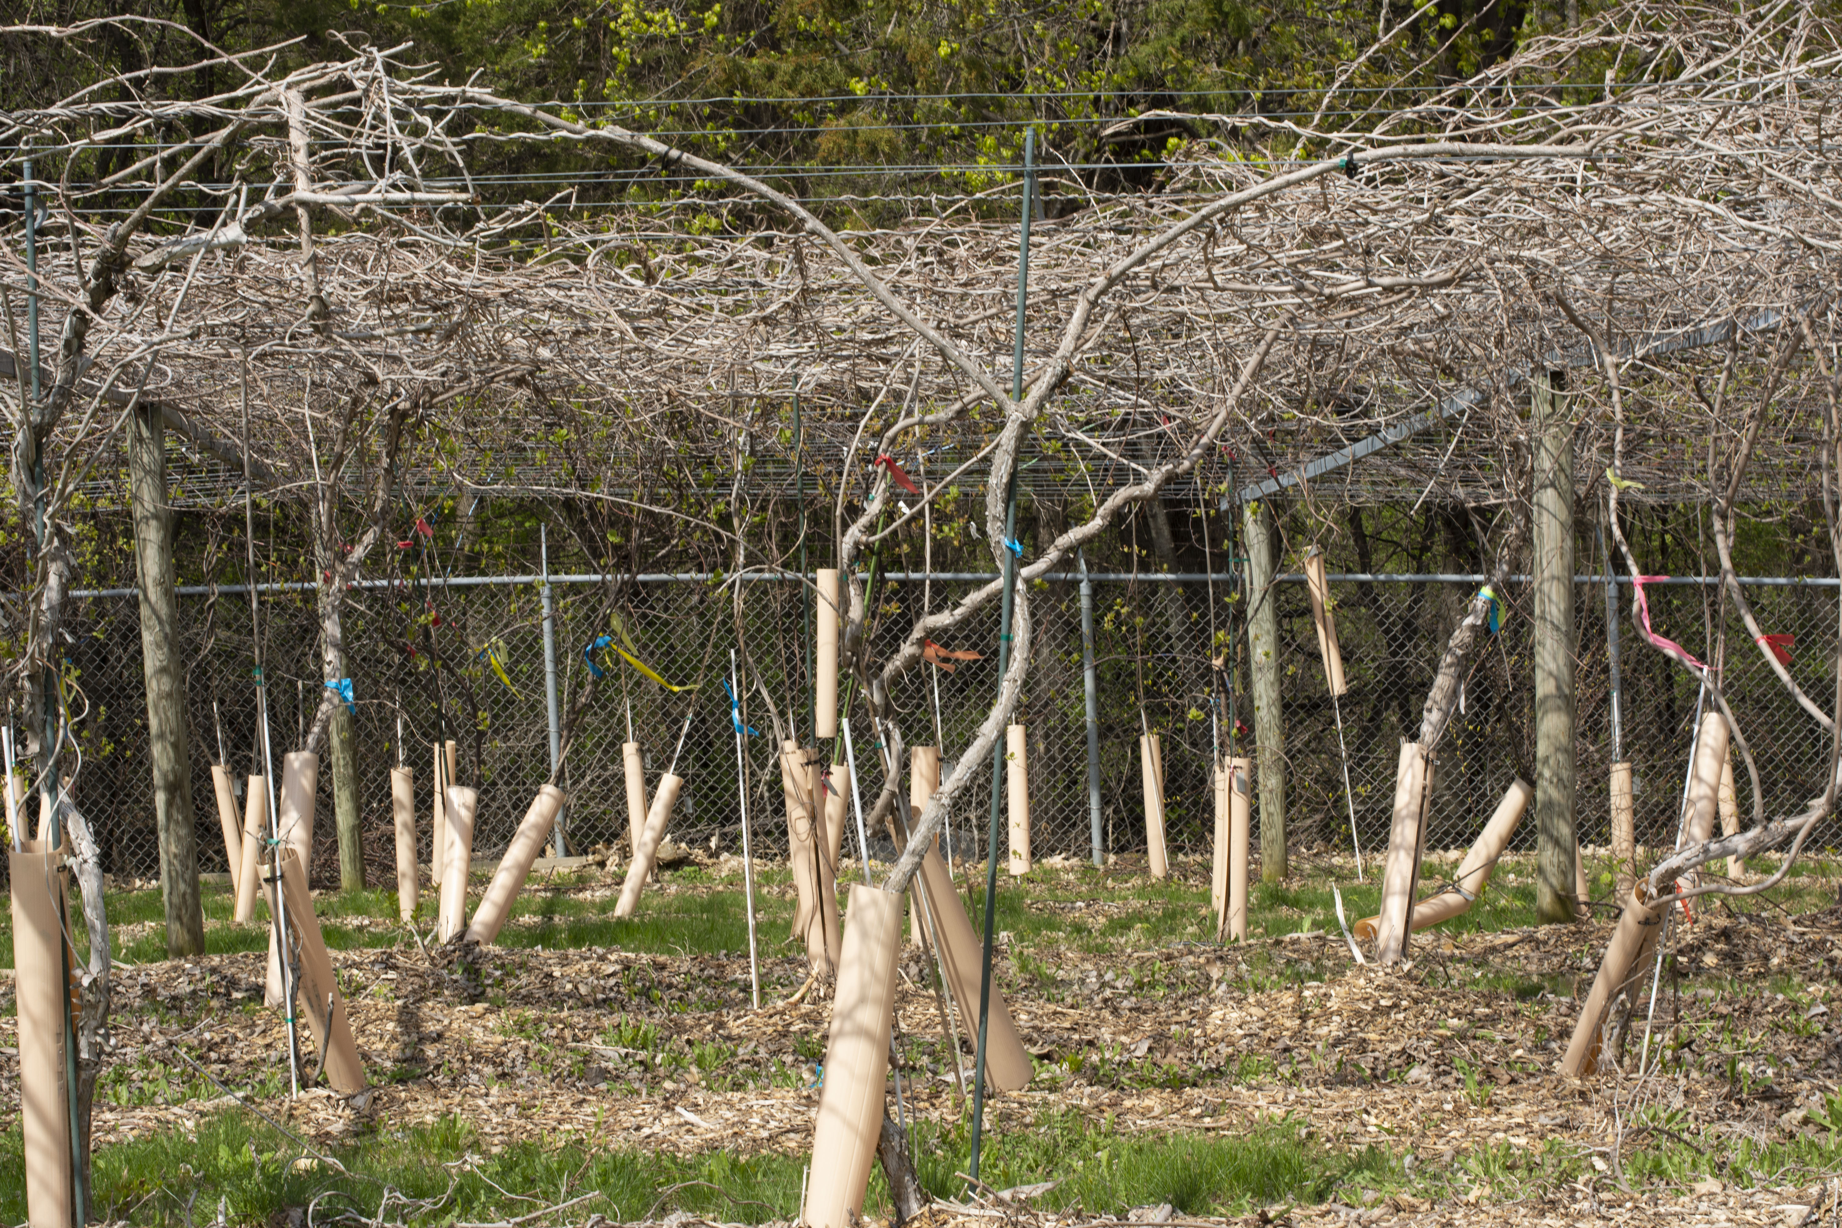
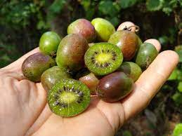
Kiwi

Slide 23
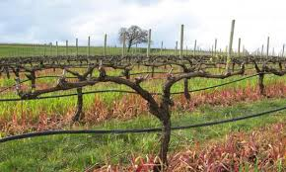
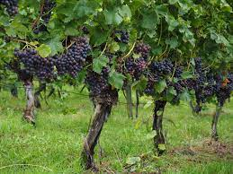
Grapes

Slide 24
Apple Tree

Slide 25
Pear Tree
Notes:
Pear Trees is not only a great tree that is cold-hardy but also does amazing in droughts, high heat, and humidity. This makes it perfect to plant anywhere in your yard, regardless of the amount of sunlight it receives.

Slide 26
Plum Tree
Notes:
https://www.alamy.com/city-street-with-plum-blossoms-in-vancouver-bc-canada-west-22nd-avenue-from-arbutus-street-image328931217.html
Perfect for Small Spaces:
Apple, Pear, & Cherry Trees grow quite large. If you don’t have a big backyard this can pose a problem. But you don’t have to worry about this with plum trees, as they won’t grow more than 8 to 10 feet high and 6-8 feet wide.

Slide 27
Peach Tree
Notes:
https://www.alamy.com/city-street-with-plum-blossoms-in-vancouver-bc-canada-west-22nd-avenue-from-arbutus-street-image328931217.html
Peach Trees do not tolerate cold weather well. While some varieties can survive Quebec’s cold weather, most will die if the winter temperatures drop consistently below 10 degrees Fahrenheit.

Slide 28
Cherry Tree
Notes:
https://www.mtlblog.com/the-cherry-blossom-tree-festival-happening-in-montreal-you-absolutely-need-to-check-out-before-its-too-late

Slide 29
Nectarine Tree
Notes:
if you live in a part of Quebec where temperatures can dip for weeks at a time below 20 degrees Fahrenheit you will need to wrap your tree in burlap to protect it from the cold.

Slide 30
Apricot Tree

Slide 31
Fruit and Berries initiatives
10 Best Fruit Trees to Grow in Quebec (2023 Guide)
https://thegardeningdad.com/best-fruit-trees-to-grow-in-quebec-2021/
Ste-Anne-de-Bellevue's food forest project embraces an ecological attempt to educate — and feed — the public.
Author of the article:Albert Kramberger; Montreal Gazette
https://montrealgazette.com/news/local-news/west-island-gazette/kramberger-from-little-things-big-things-grow
City street with Plum Blossoms in Vancouver BC Canada, West 22nd Avenue from Arbutus Street
https://www.alamy.com/city-street-with-plum-blossoms-in-vancouver-bc-canada-west-22nd-avenue-from-arbutus-street-image328931217.html
The Montreal "Cherry Blossom Tree Festival" You Need To Check Out Before It's Too Late
https://www.mtlblog.com/the-cherry-blossom-tree-festival-happening-in-montreal-you-absolutely-need-to-check-out-before-its-too-late

Slide 32
Discussion
What kind of berries would you add to your garden?
What berries do you like eating?
What storage/transformation capabilities do you have?
What plants do you like?
Ornamental vs eating
Where would you grow your berries?
How much space do you have?
How would you maintain your berry plants?
What does your plant need to survive and thrive?
How will you acquire your berry plant?
Propagate, from seed, buy from store, get from nature?

Slide 33
Thanks!
Questions or concerns?

