Slide 1
Cultivating Urban Greenspaces
Incorporating Perennial Berries
www.cultivaction.ca

Slide 2
Question?
What is a Perennial Plant?

Slide 3
What is a Perennial Plant?
Annual – Plant takes one year to complete its cycle (must be reseeded)
Biennial – Plant takes two year to complete its cycle (must be reseeded after two years)
Perennial – Plant lives for multiple years before its life cycle is complete

Slide 4
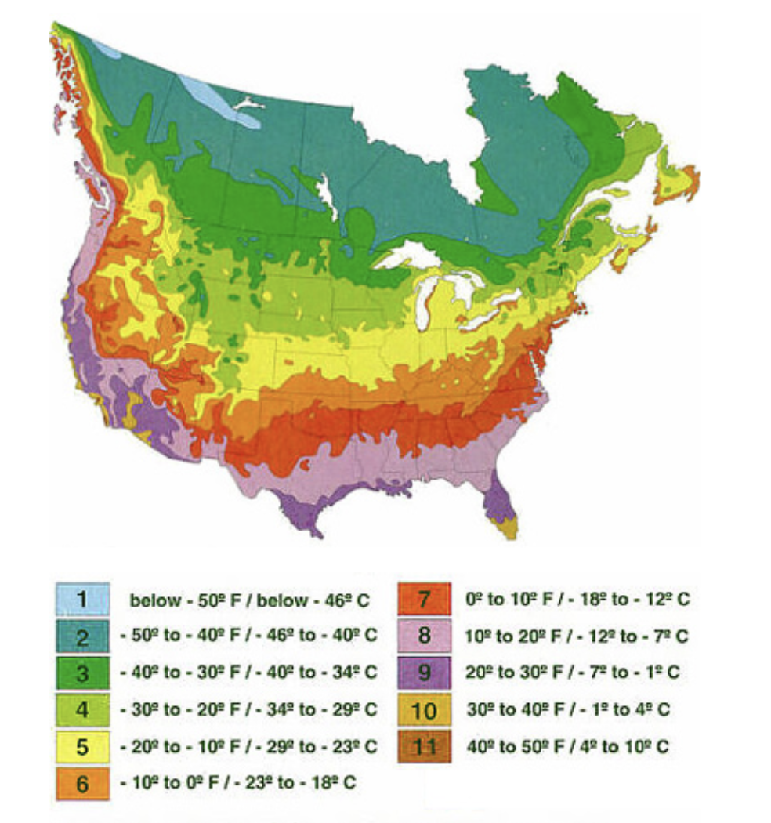
Hardiness Zones
Plant Hardiness Link Government of Canada

Slide 5
Discussion
Do you want to incorporate perennial fruits and berries into the garden?
If so, what types of fruits and berries do you like?
What types of fruits and berries can we grow in Montreal’s hardiness zone? Name as many as you can and tell us about them.

Slide 6
List of Berries That Grow In Montreal
Berries
Gooseberry
Raspberry
Blackberry
Haskap Berry
Kiwi Berries
Currants
Serviceberries
Strawberries
Elderberries
Blueberries
Mulberries
Grapes
Aronia Berries
Bunchberries
Goji Berries
Sea Buckthorn
Boysenberry

Slide 7
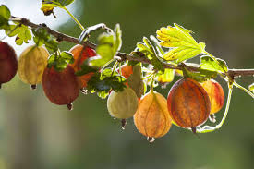
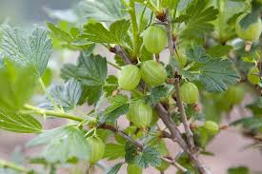
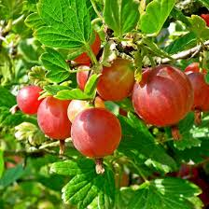
Gooseberry

Slide 8
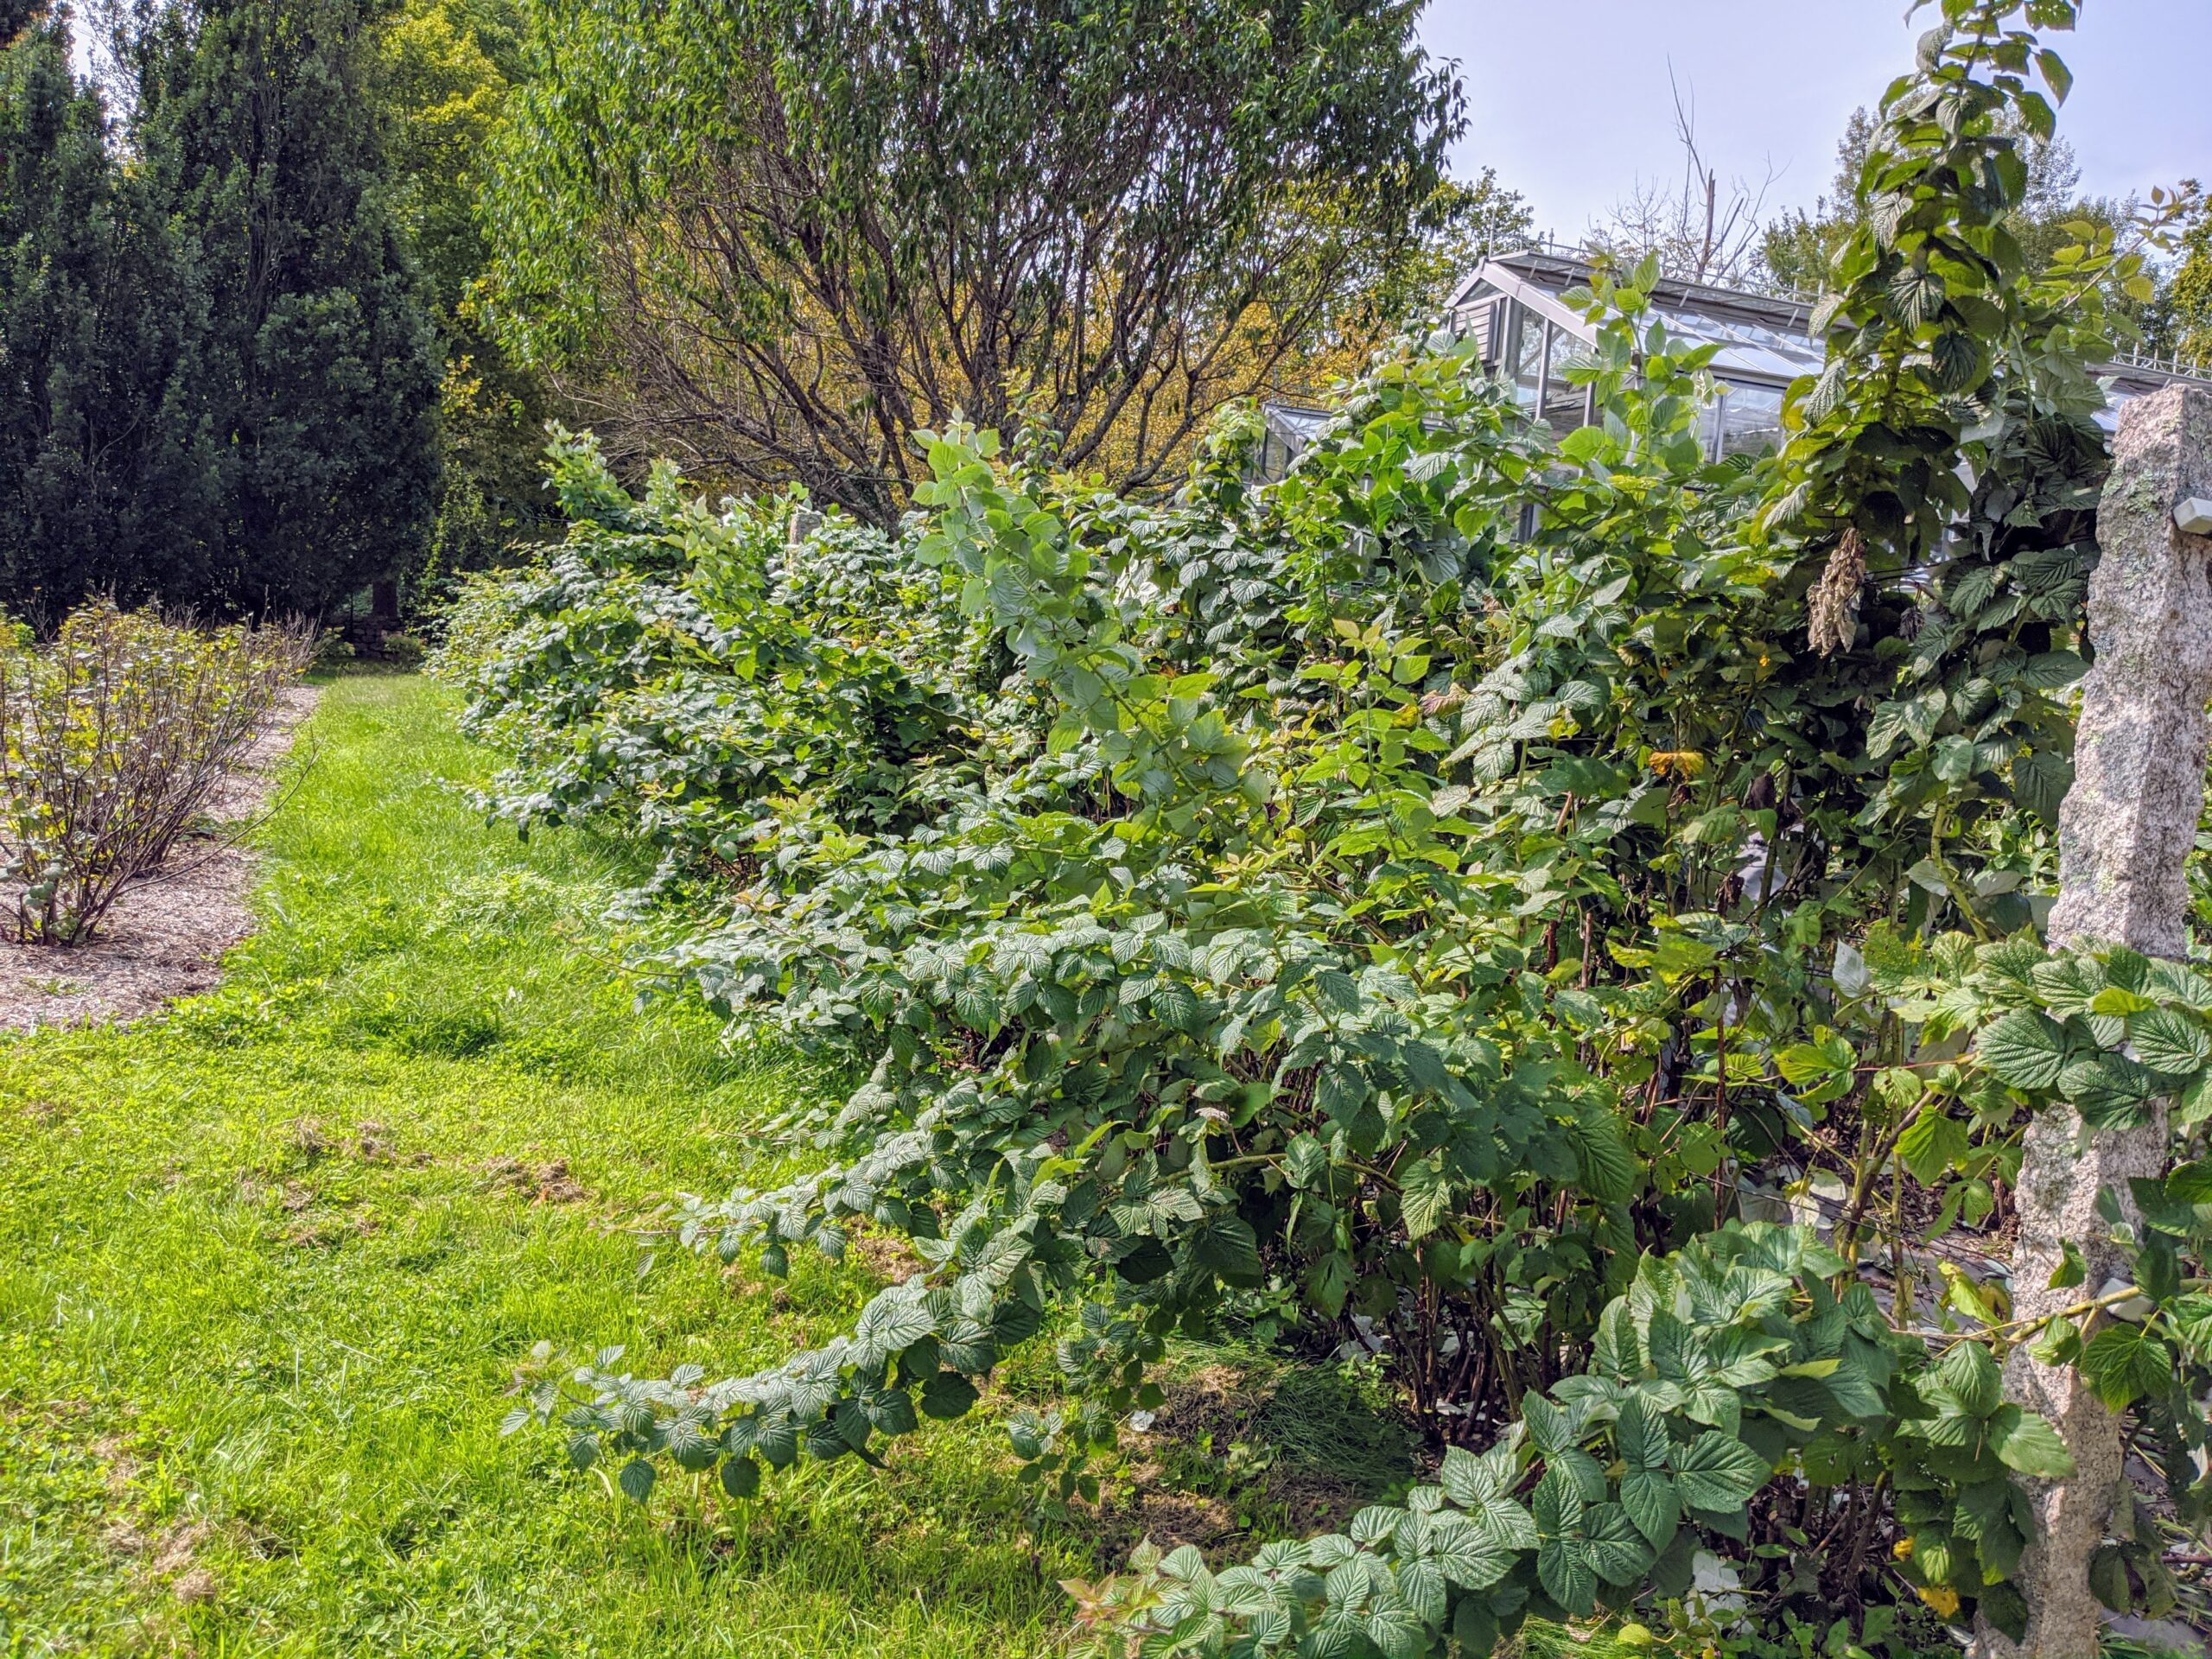
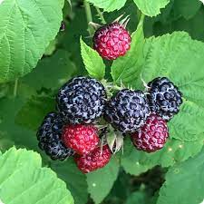
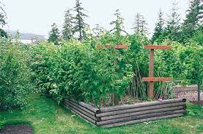
Raspberry

Slide 9
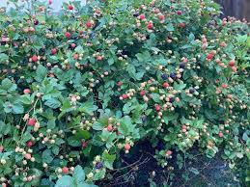
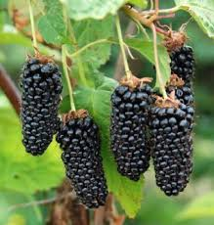
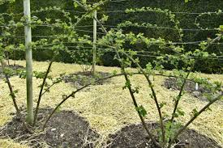
Blackberry

Slide 10
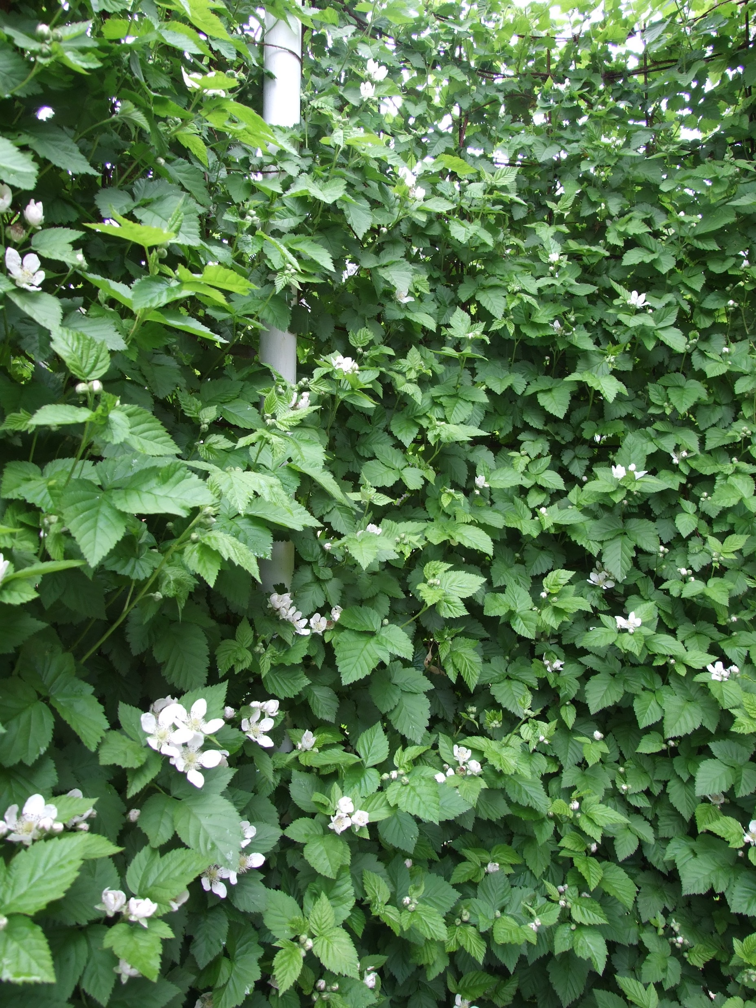
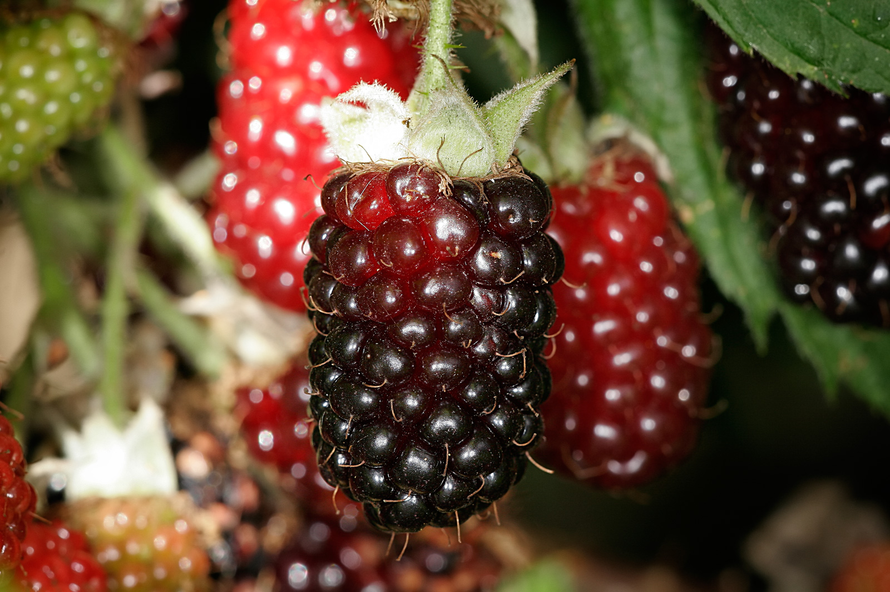
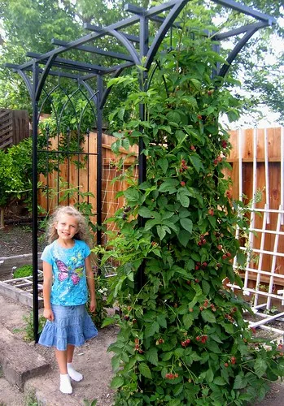
Boysenberry

Slide 11
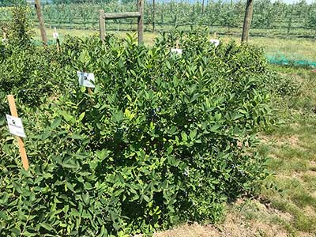
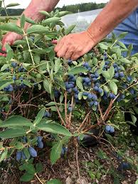
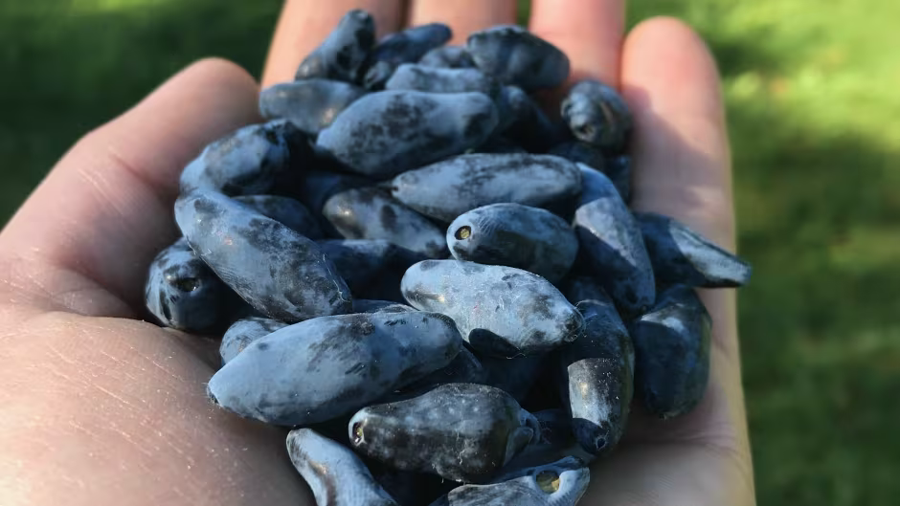
Haskap Berries

Slide 12
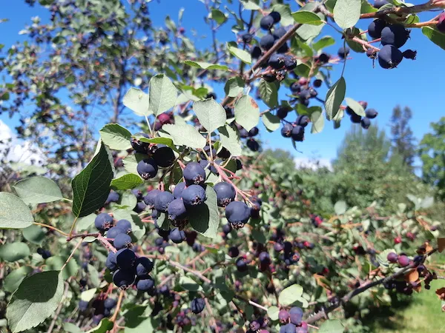
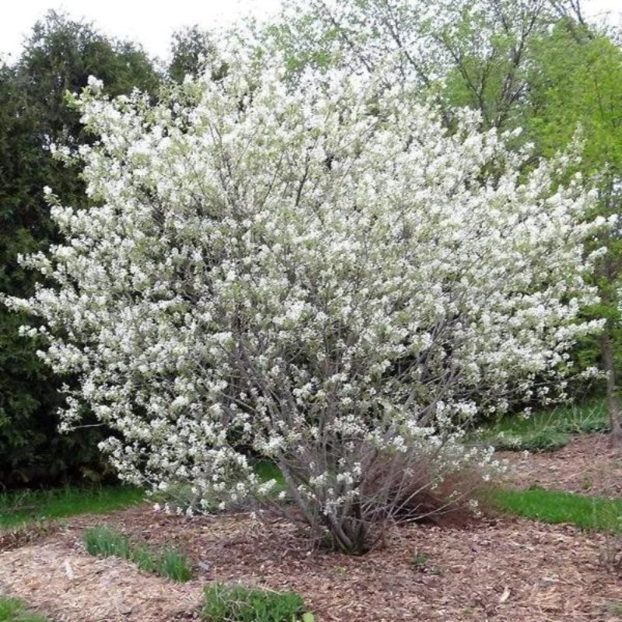
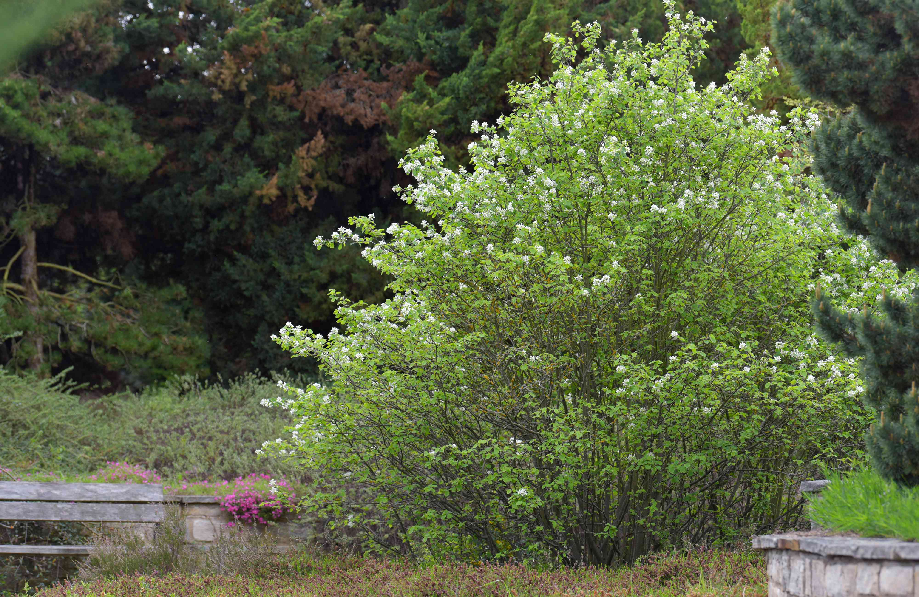
Serviceberry

Slide 13
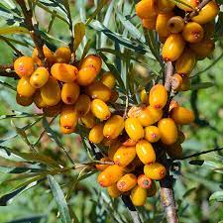
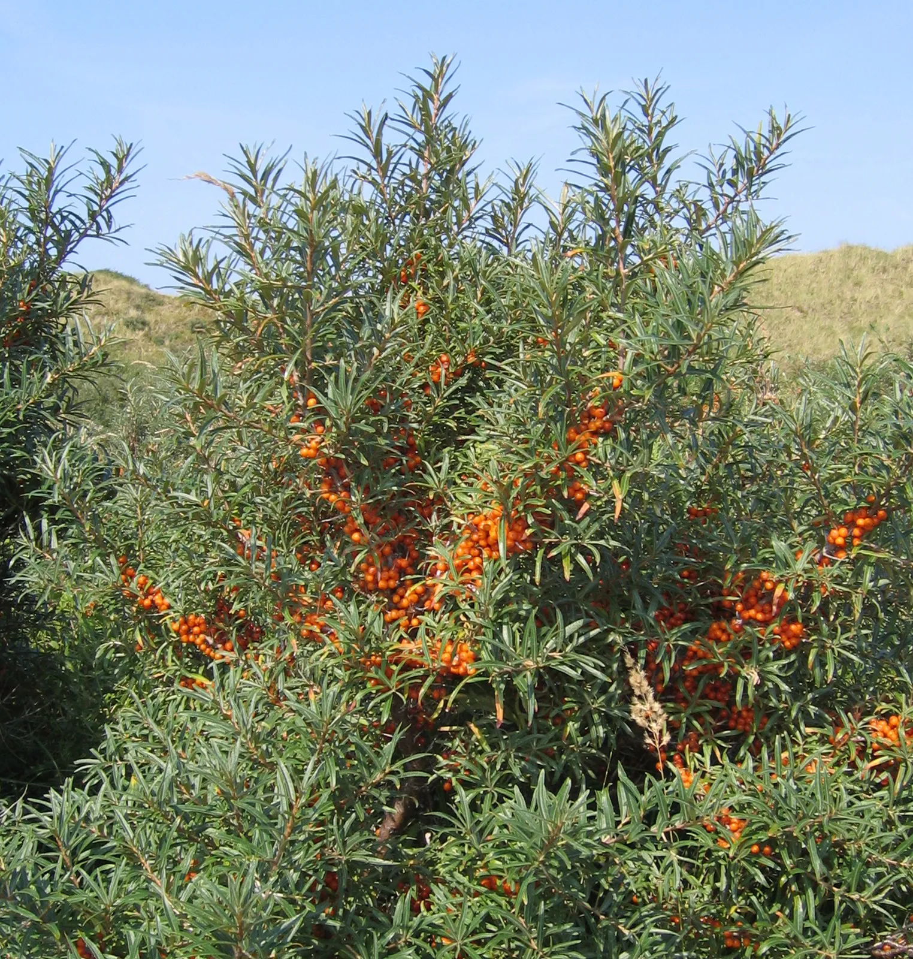
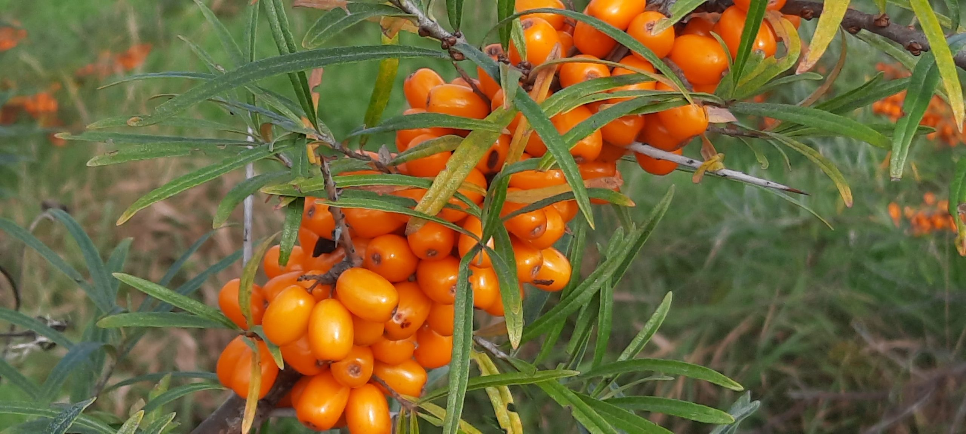
Sea Buckthorn

Slide 14
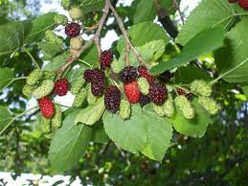
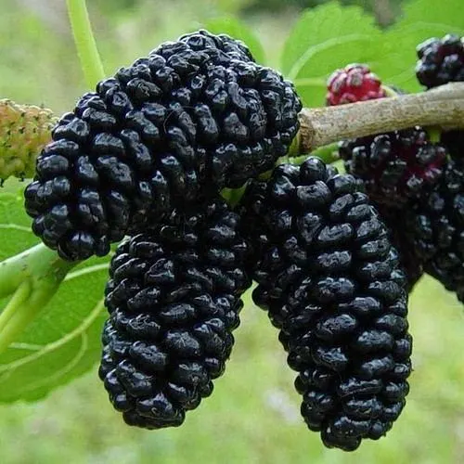
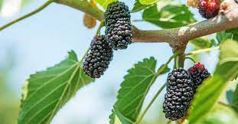
Mulberry

Slide 15
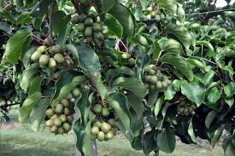
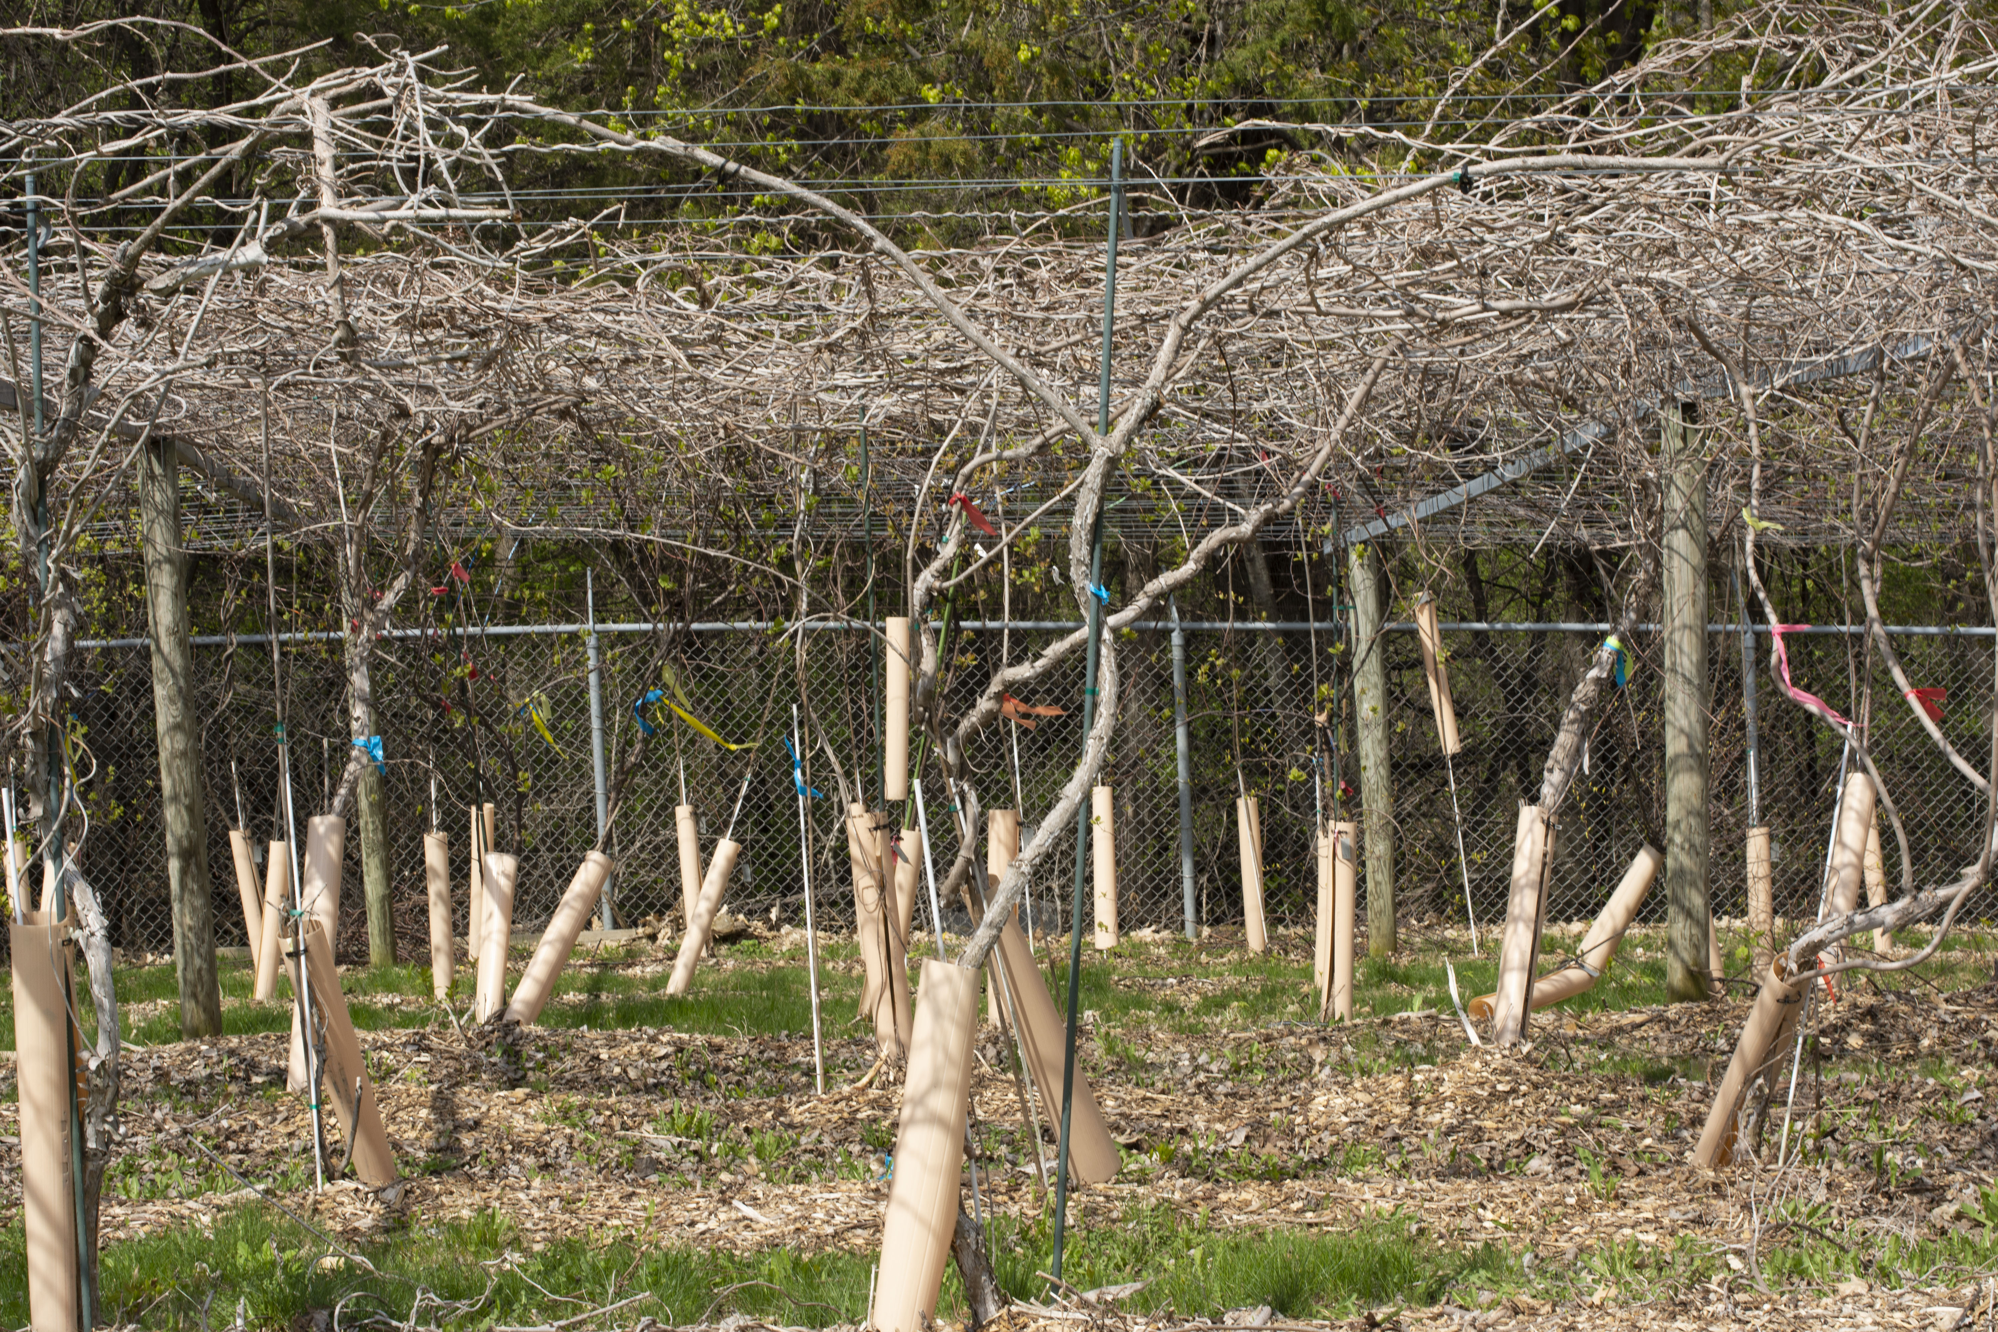
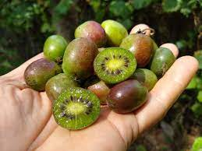
Kiwi Berry

Slide 16
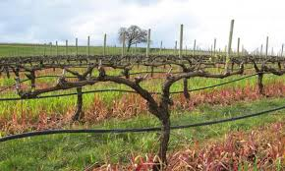
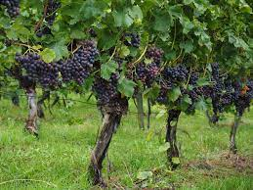
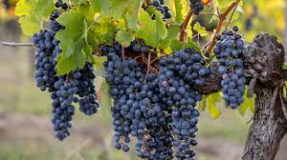
Grapes

Slide 17
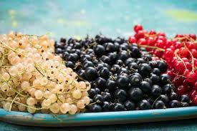
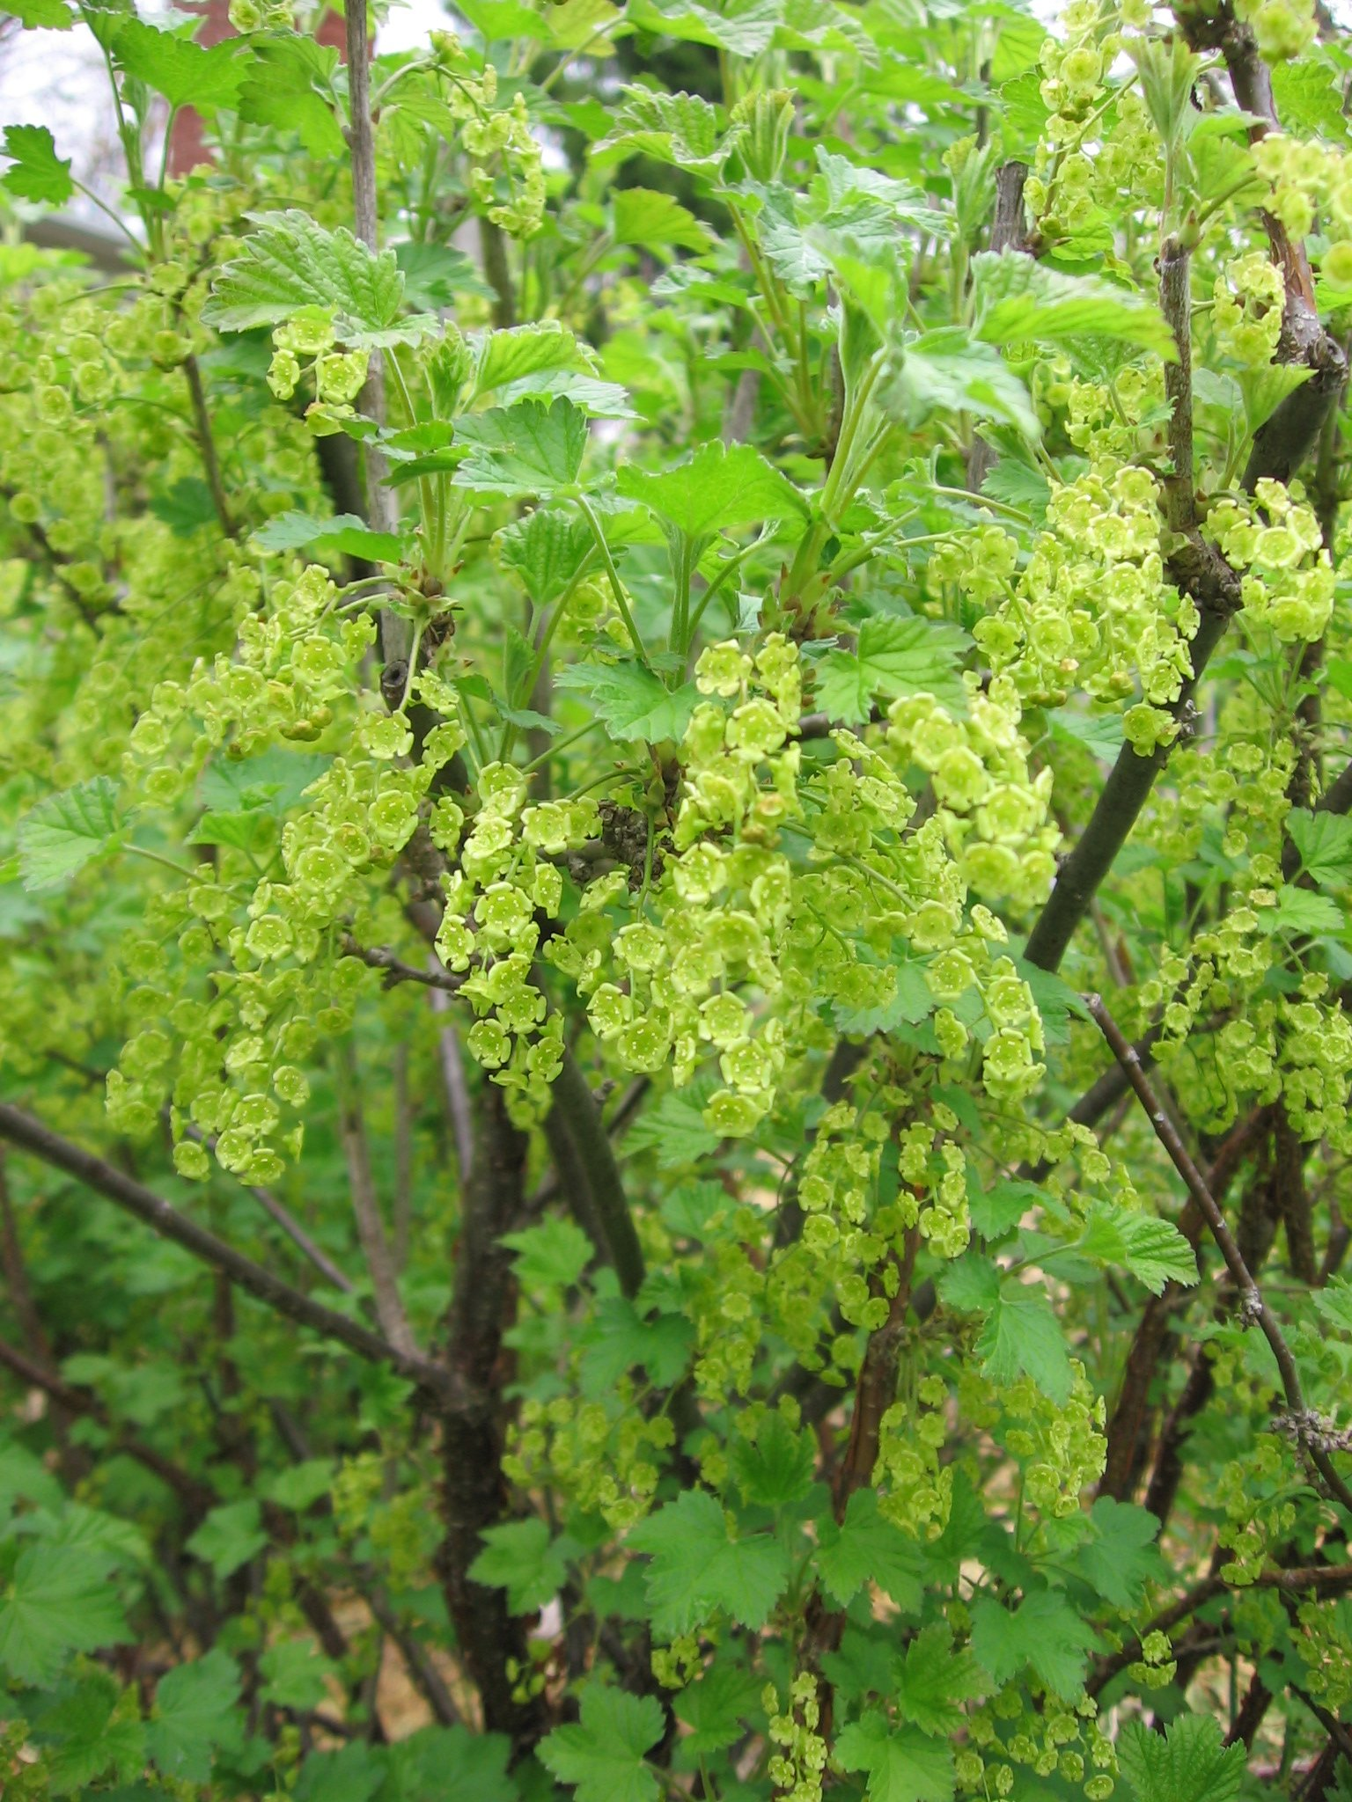
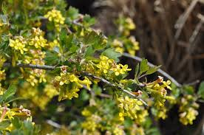
Currant

Slide 18
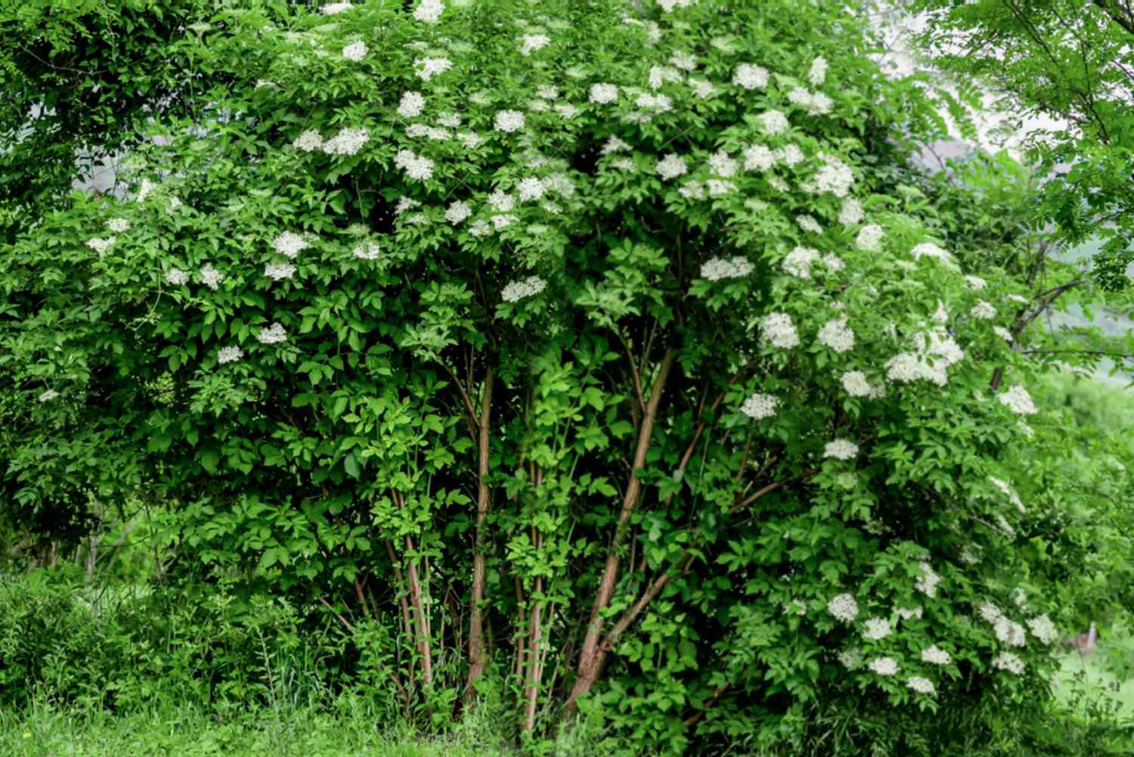
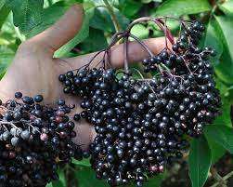
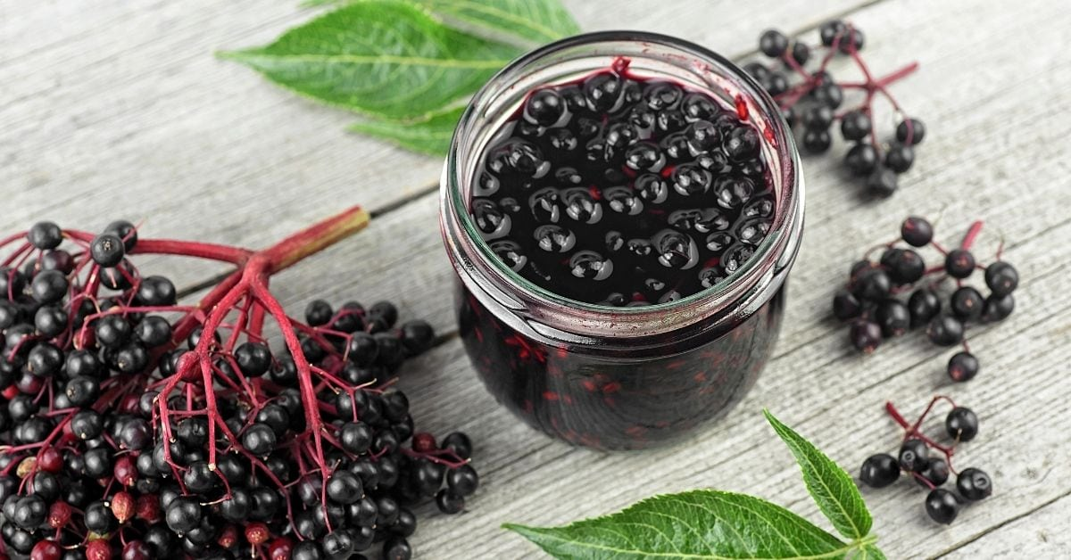
Elderberry

Slide 19
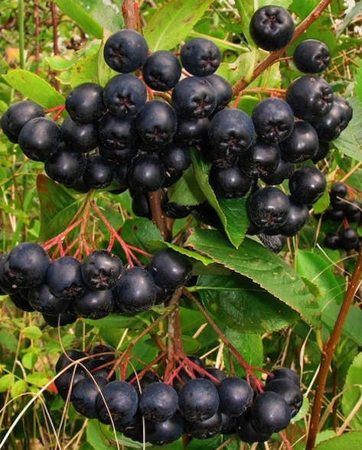
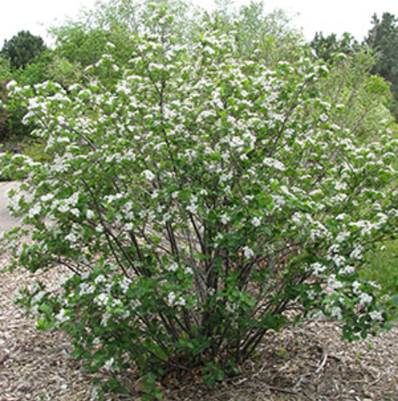
Aronia Berries

Slide 20
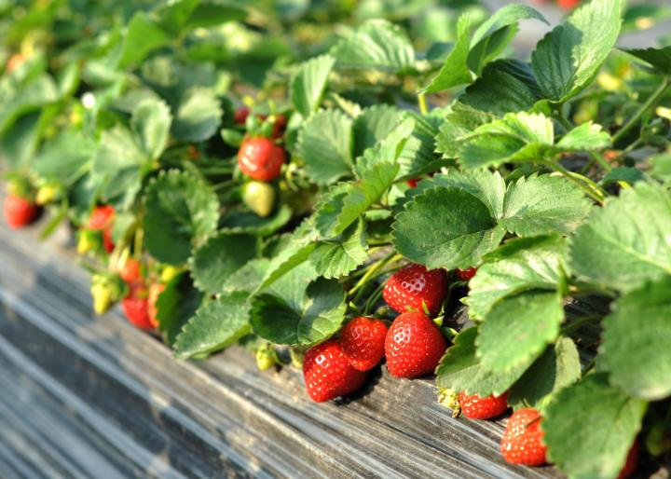
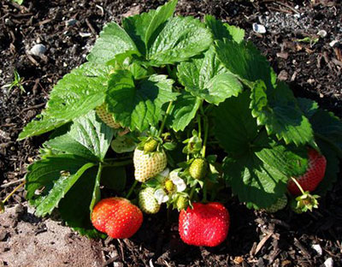
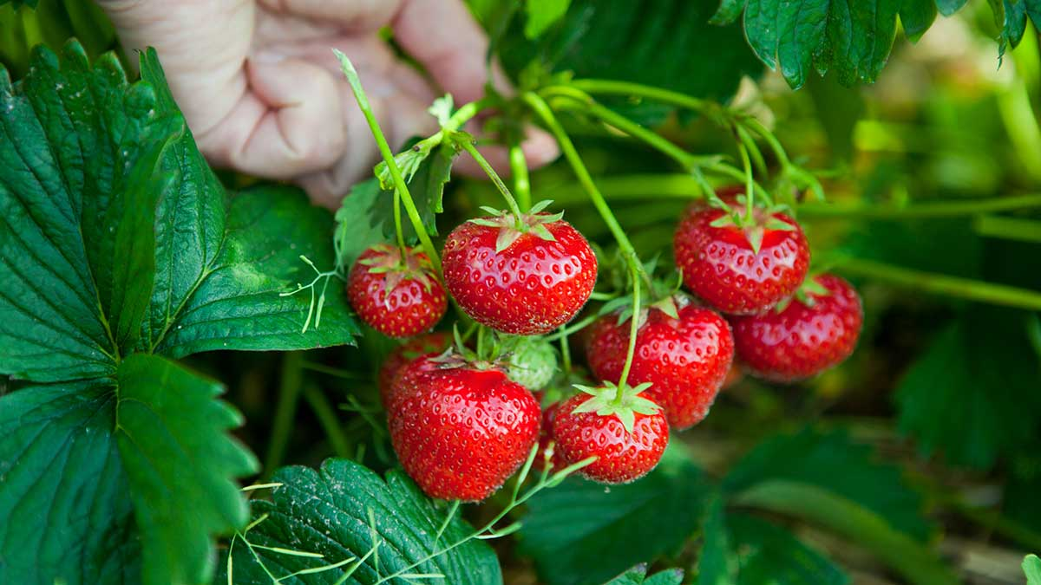
Strawberries

Slide 21
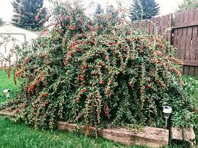
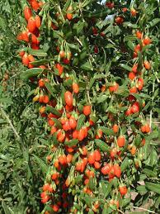
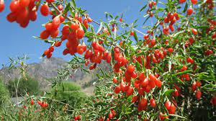
Goji Berries

Slide 22
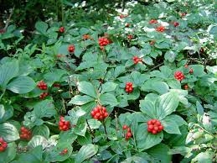
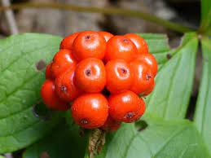
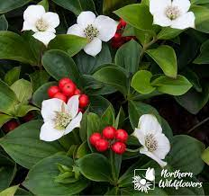
Bunchberry

Slide 23
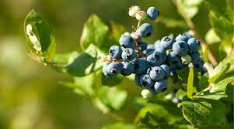
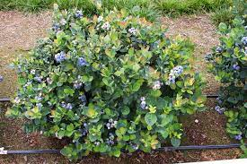
Blueberry

Slide 24
Discussion
What kind of berries would you add to your garden?
What berries do you like eating?
What storage/transformation capabilities do you have?
What plants do you like?
Ornamental vs eating
Where would you grow your berries?
How much space do you have?
How would you maintain your berry plants?
What does your plant need to survive and thrive?
How will you acquire your berry plant?
Propagate, from seed, buy from store, get from nature?

Slide 25
Thanks!
Questions or concerns?

